Slide 1
CPEX Portal Status
Svetla Hristova-Veleva, Brian Knosp, P. Peggy Li, Quoc Vu, F. Joe Turk
Bjorn Lambrigtsen, Hui Su, Shuyi Chen, Ed Zipser
Ramesh Kakar
CPEX Science Team Meeting
June 7, 2018
©2018. All rights reserved.

Slide 2
CPEX Website https://cpex.jpl.nasa.gov
Served as the official project website, offering the following resources:
Event Calendar
Flight and Science Summaries
Daily Forecast Reports
Quicklook Images
Information about aircraft and instruments
Team contact information and campaign image gallery
Gateway to related data resources –
Data Portal (https://cpexportal.jpl.nasa.gov )
FTP server for all observed data and GFS
Model Forecast pages, etc.
The FTP server

Slide 3
CPEX FTP Server ftp://mwsci.jpl.nasa.gov/outgoing/cpex
For easy download, data is organized by instruments and dates/flights, including:
satellite data CPEX airborne data GFS model forecasts
Satellite data is subsetted into the CPEX domain for the campaign time period
Cloud and Precipitation
GOES (IR, VIS, water vapor),
Microwave (GPM constellation) - microwave brightness temperature (AMSR2, GMI, SSMIS) and JPL Rain Indicator product
Level 3 precipitation product IMERG GPM,
Thermodynamics - AIRS L2, TPW from Metop-B, NOAA-18 and NOAA-19, AAMH Microwave sounder data product from AMSU-A and MHS,
Surface
Wind ASCAT Wind, SMAP wind speed, (CYGNSS only for visualization)
SST - MUR 1km SST
Aerosol Loading - MODIS AOT from Terra
The latest airborne CPEX science quality data is available from the instrument PIs
HAMSR, APR3, dropsonde, DAWN and DC8 flight tracks.
Daily GFS forecast at 00Z for 120 hours at every 12 hours interval
Relative humidity, temperature, wind vectors, vertical velocity at different pressure levels; sfc and integral

Slide 4
CPEX Data Portal https://cpexportal.jpl.nasa.gov
Integrates model forecasts with satellite and airborne observations from a variety of instruments and platforms, allowing for easy model/observations comparisons
Visualization of satellite data, model forecast, and airborne data products on a 3D global Earth using Cesium (a Google Earth-like web-based 3D Virtual Globe Platform).
Allows interrogation of a large number of atmospheric and ocean variables to better understand the large-scale and storm-scale processes associated with tropical convection.
Overlays multiple types of products with opacity adjustment and separate calendars for model and data for easy comparison.
On-line analyses Tolls - Allows access to raw data associated with the images for interactive analysis.
Subsetting tools are built in so users can select circular or rectangular areas, lines, or points on the globe.
MySQL and Solr databases are used to provide temporal and geospatial search to find the satellite swaths that intersect with the selected area.
Provides very rich information source during the analysis stages of the field campaign.
Supports data exploration and visual investigation of all the relevant data products that describe the physical processes in the CPEX domain before, during, and after the campaign.

Slide 5
Airborne data in the CPEX data portal

Slide 6
Dropsondes (KML)
Hourly Tracks

Slide 7
APR2 KML
Hourly Tracks

Slide 8
DAWN KML
Hourly Tracks
Mission Tracks

Slide 9
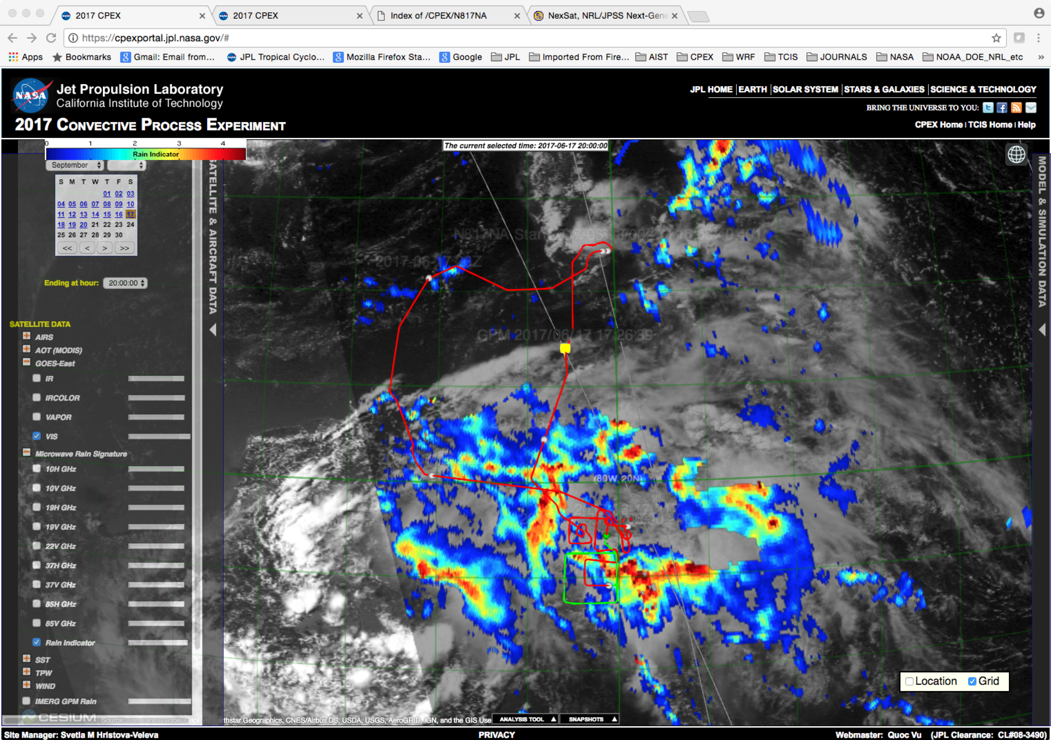
Satellite and Airborne observations of hurricane Cindy, collected during NASA’s CPEX.
Illustrated is the storm structure during the hurricane formation stages on June 17th 2017. The DC-8 flight track (in red) is plotted over the the visible and passive microwave satellite observations, with the latest hour of the flight plotted in green. The inset shows the APR-2 observations of the storm structure.
Such data, and more are available from the CPEX web site ( https://cpex.jpl.nasa.gov ) that was developed at JPL.

Slide 10
Satellite Data - The June 11 case

Slide 11
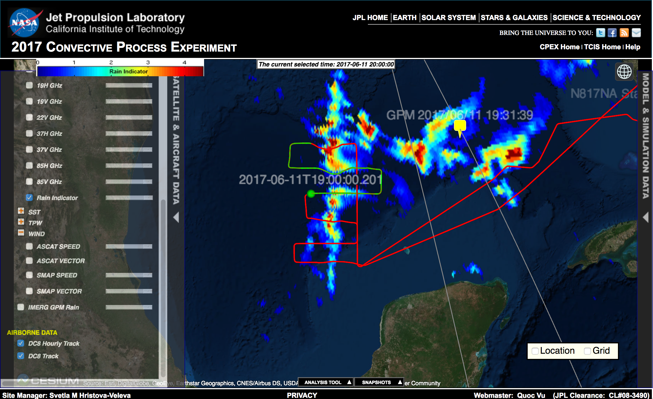

Slide 12
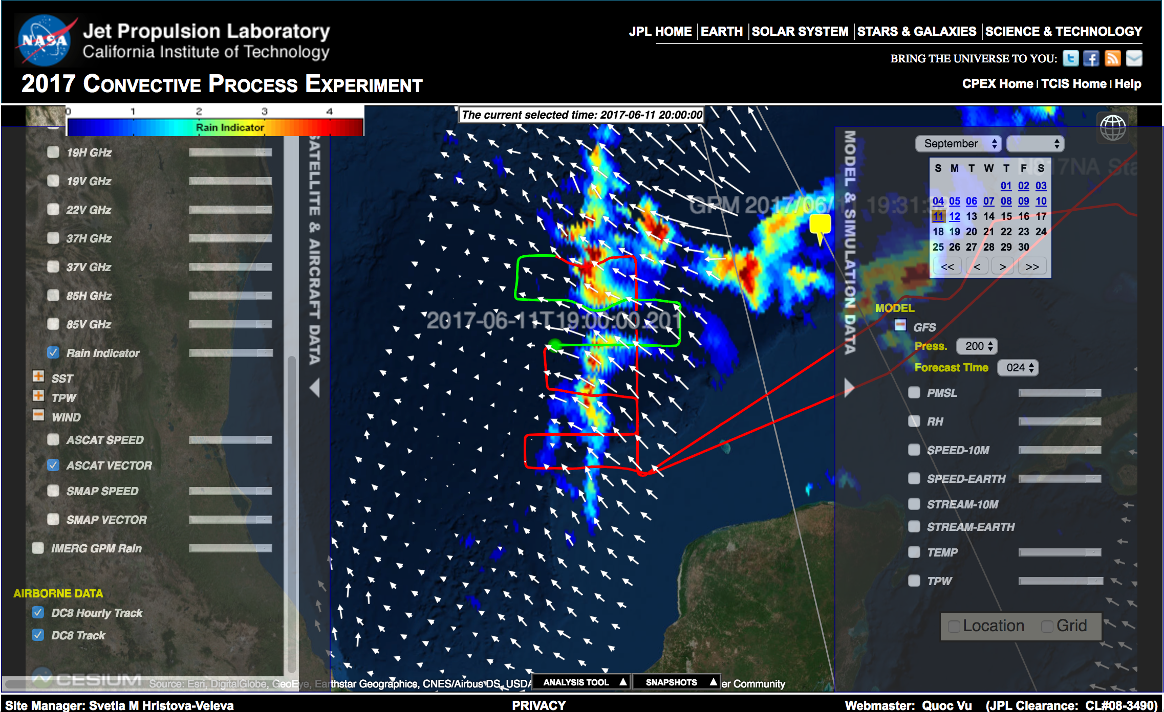

Slide 13
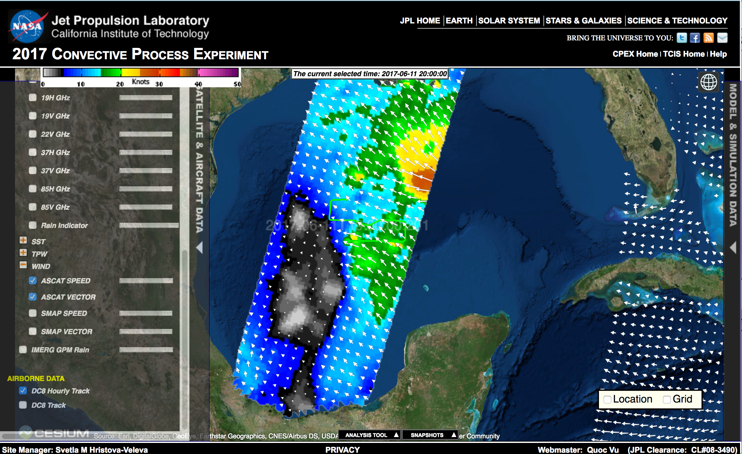
ASCAT; 16Z

Slide 14
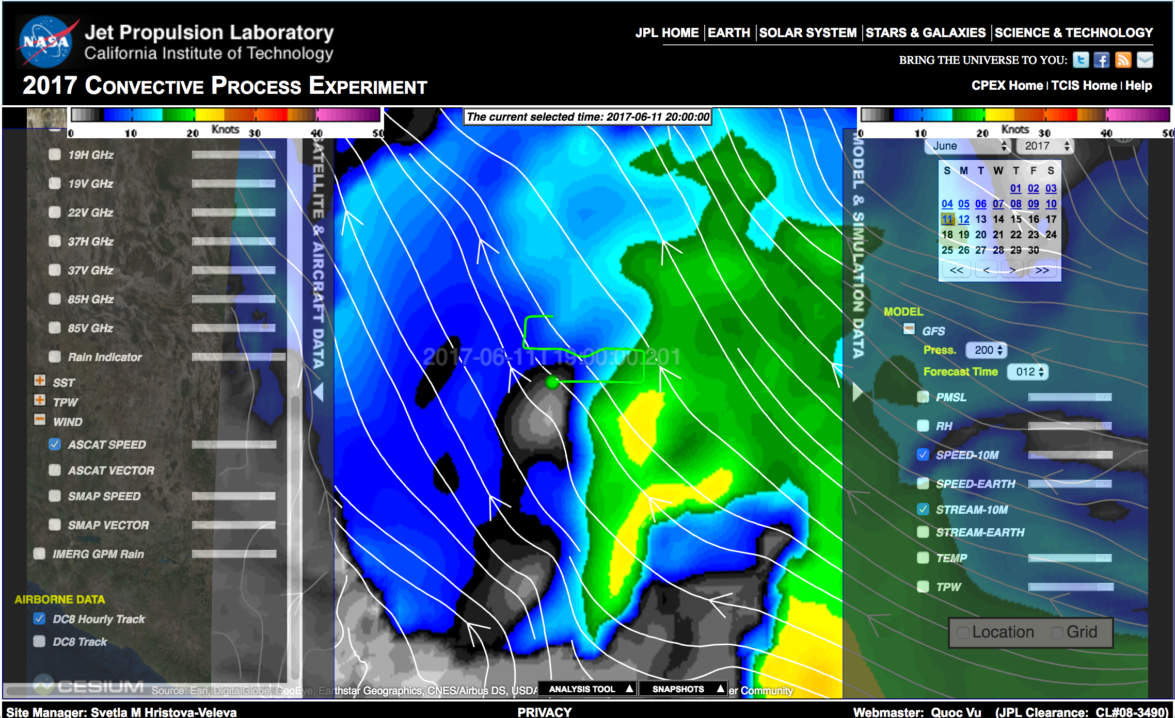
GFS: 12h forecast; valid at 12Z

Slide 15
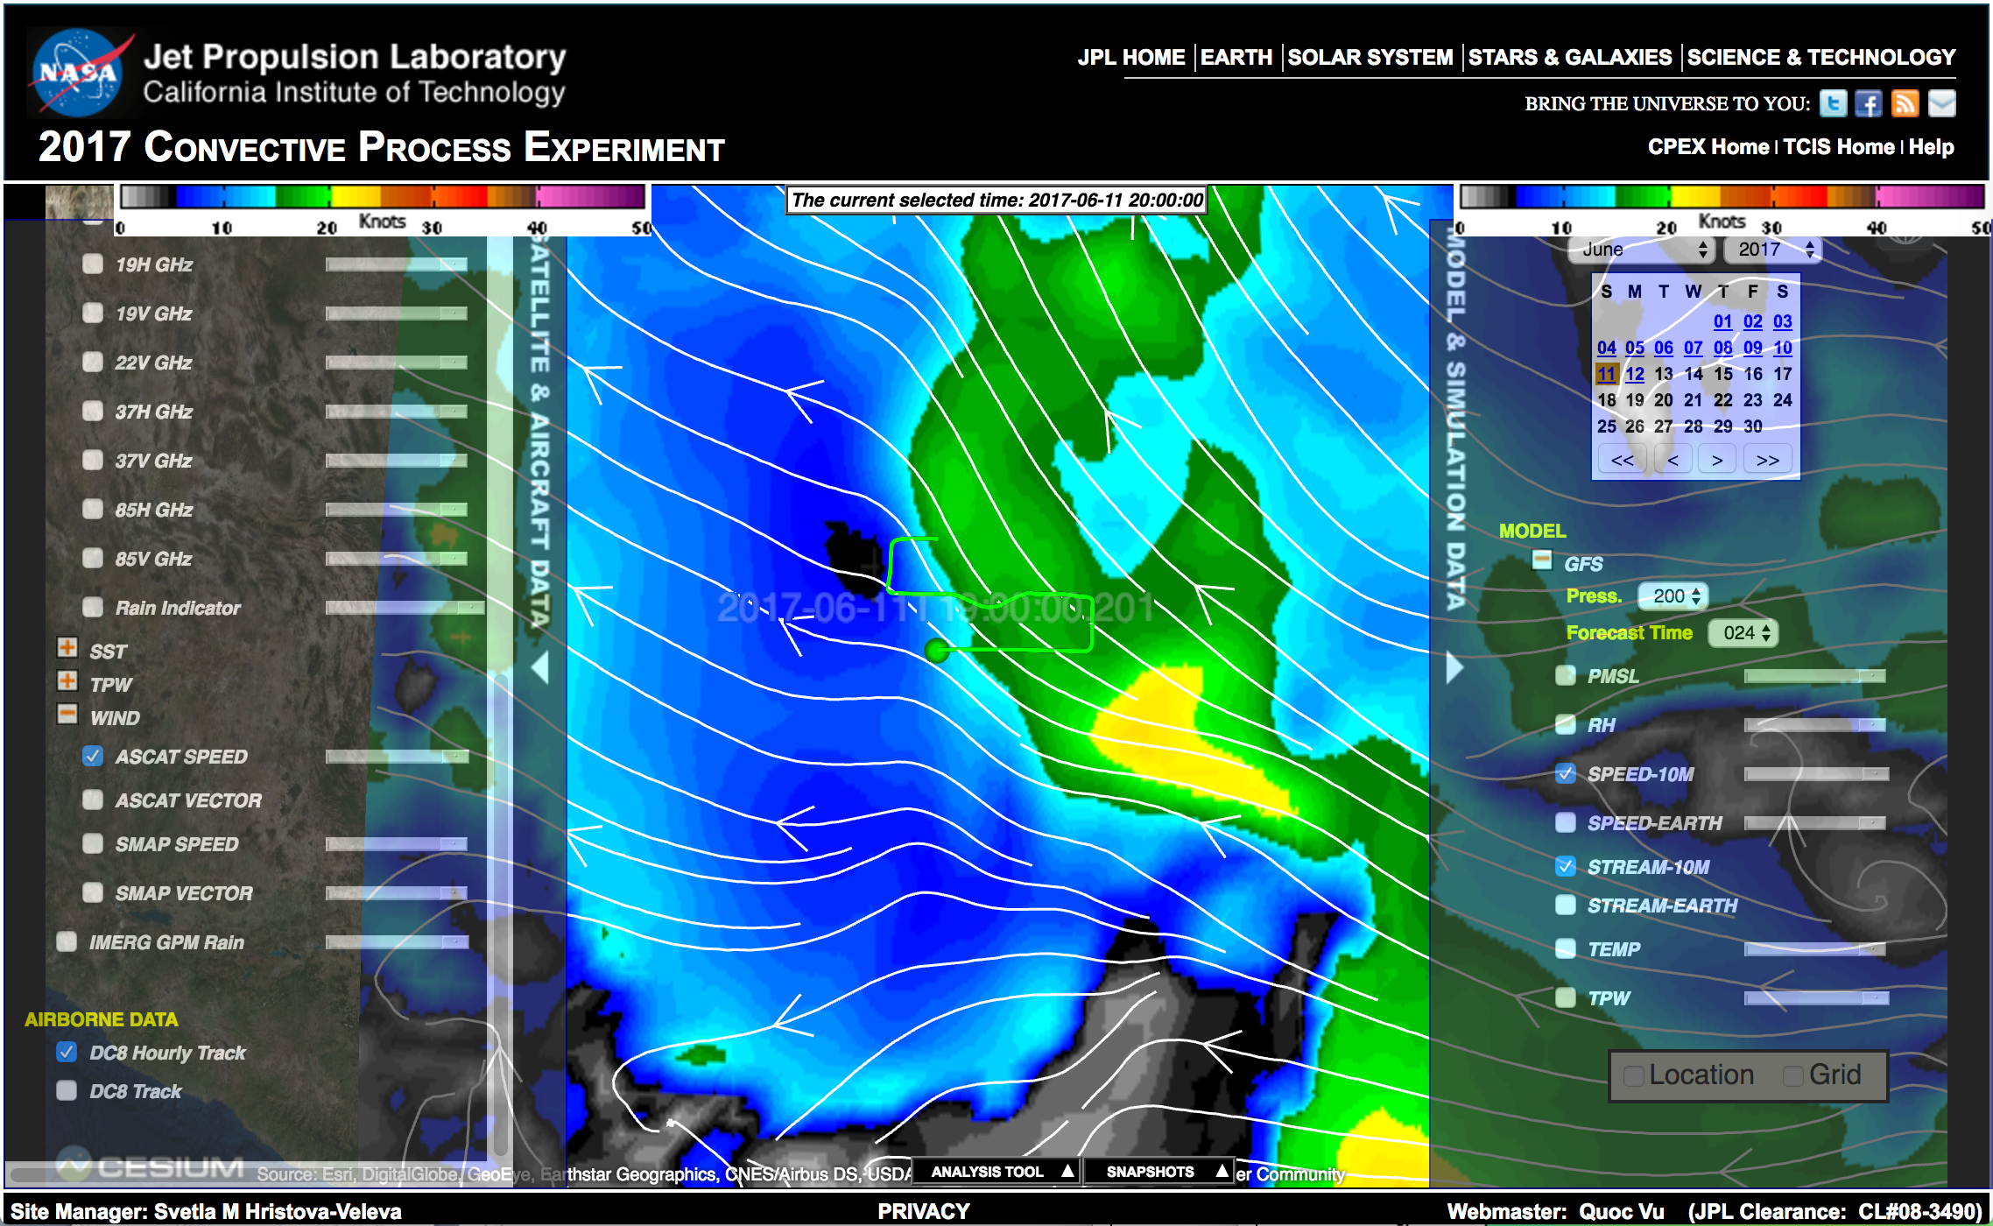
GFS: 24h forecast; valid at 00Z on the 12th

Slide 16
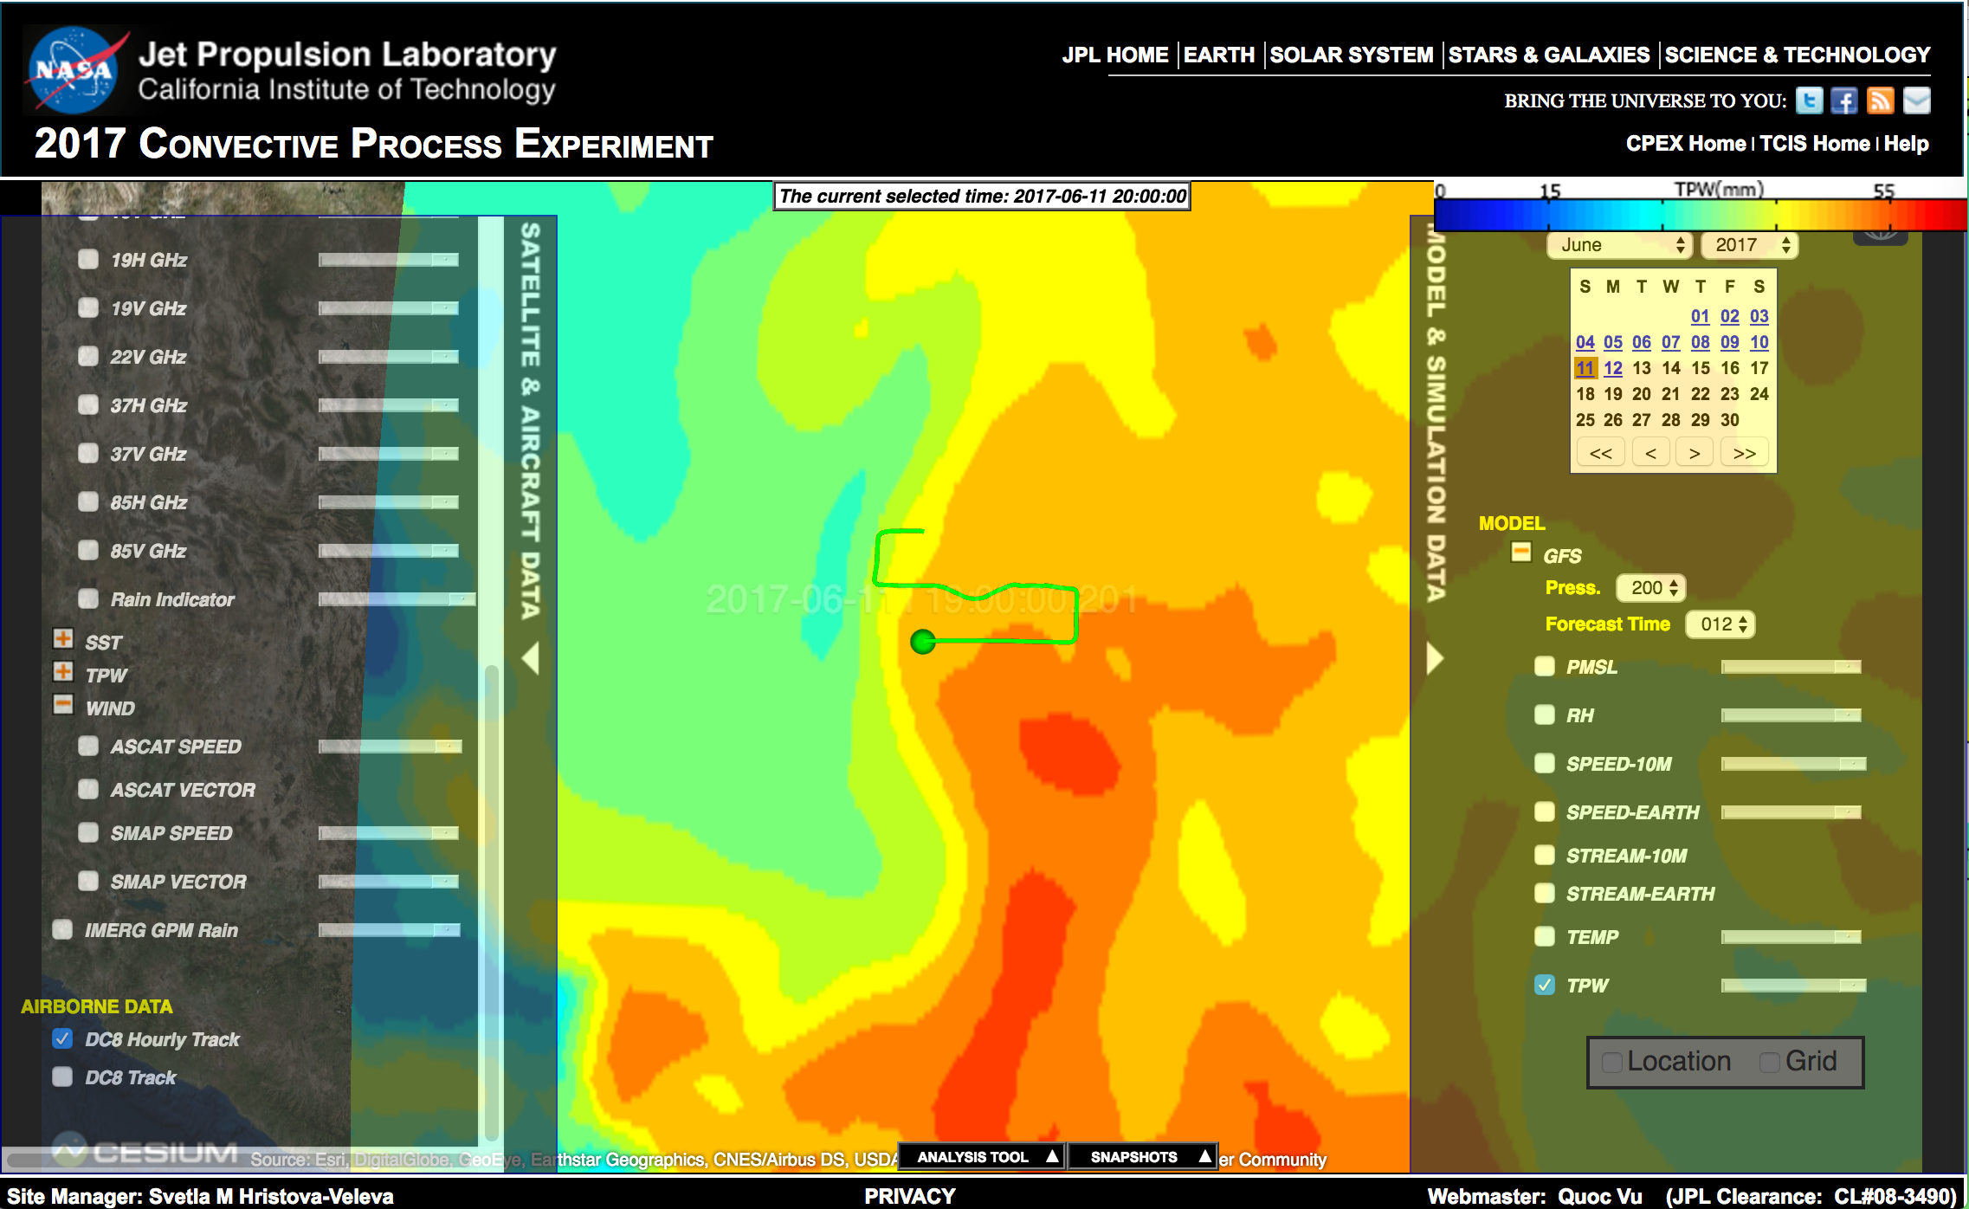
GFS: TPW; 12h forecast, valid at 12Z on the 11th

Slide 17
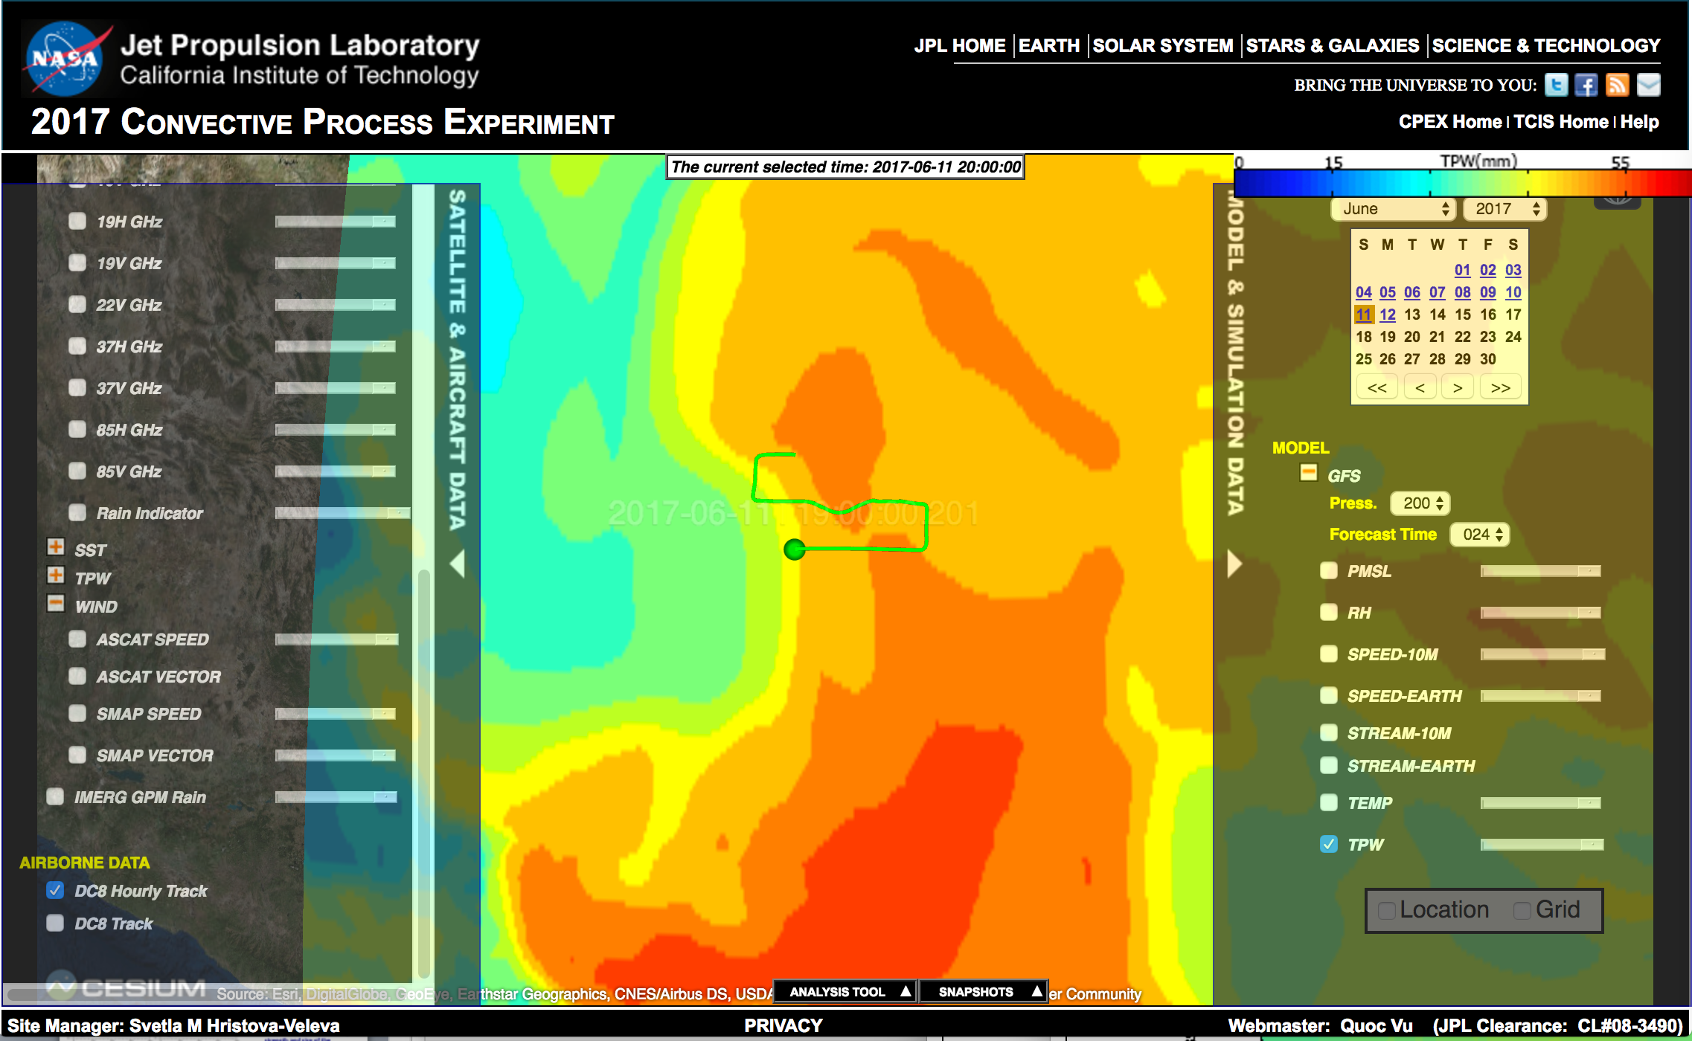
GFS: TPW; 24h forecast, valid at 00Z on the 12th

Slide 18
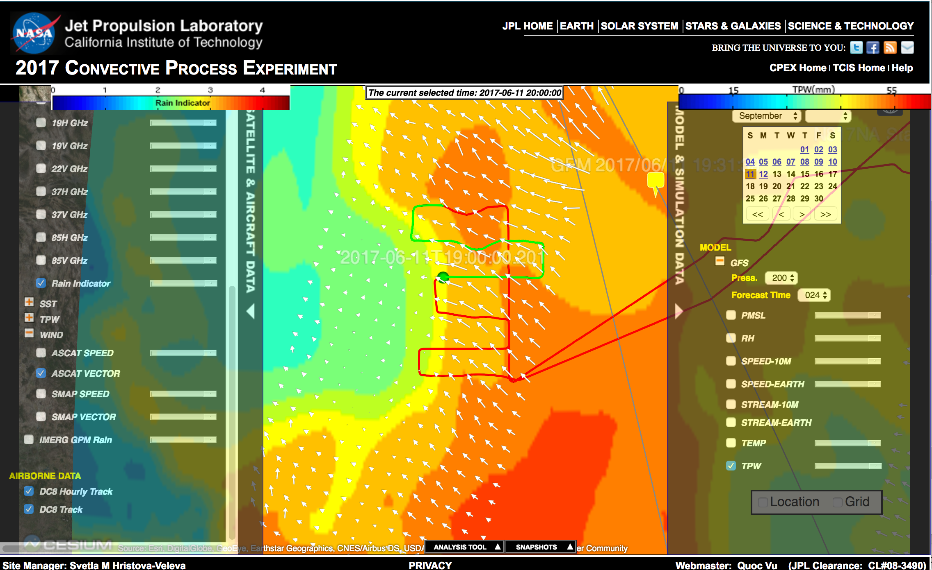
GFS: TPW; 24h forecast, valid at 00Z on the 12th ASCAT at 16Z On the 11th

Slide 19
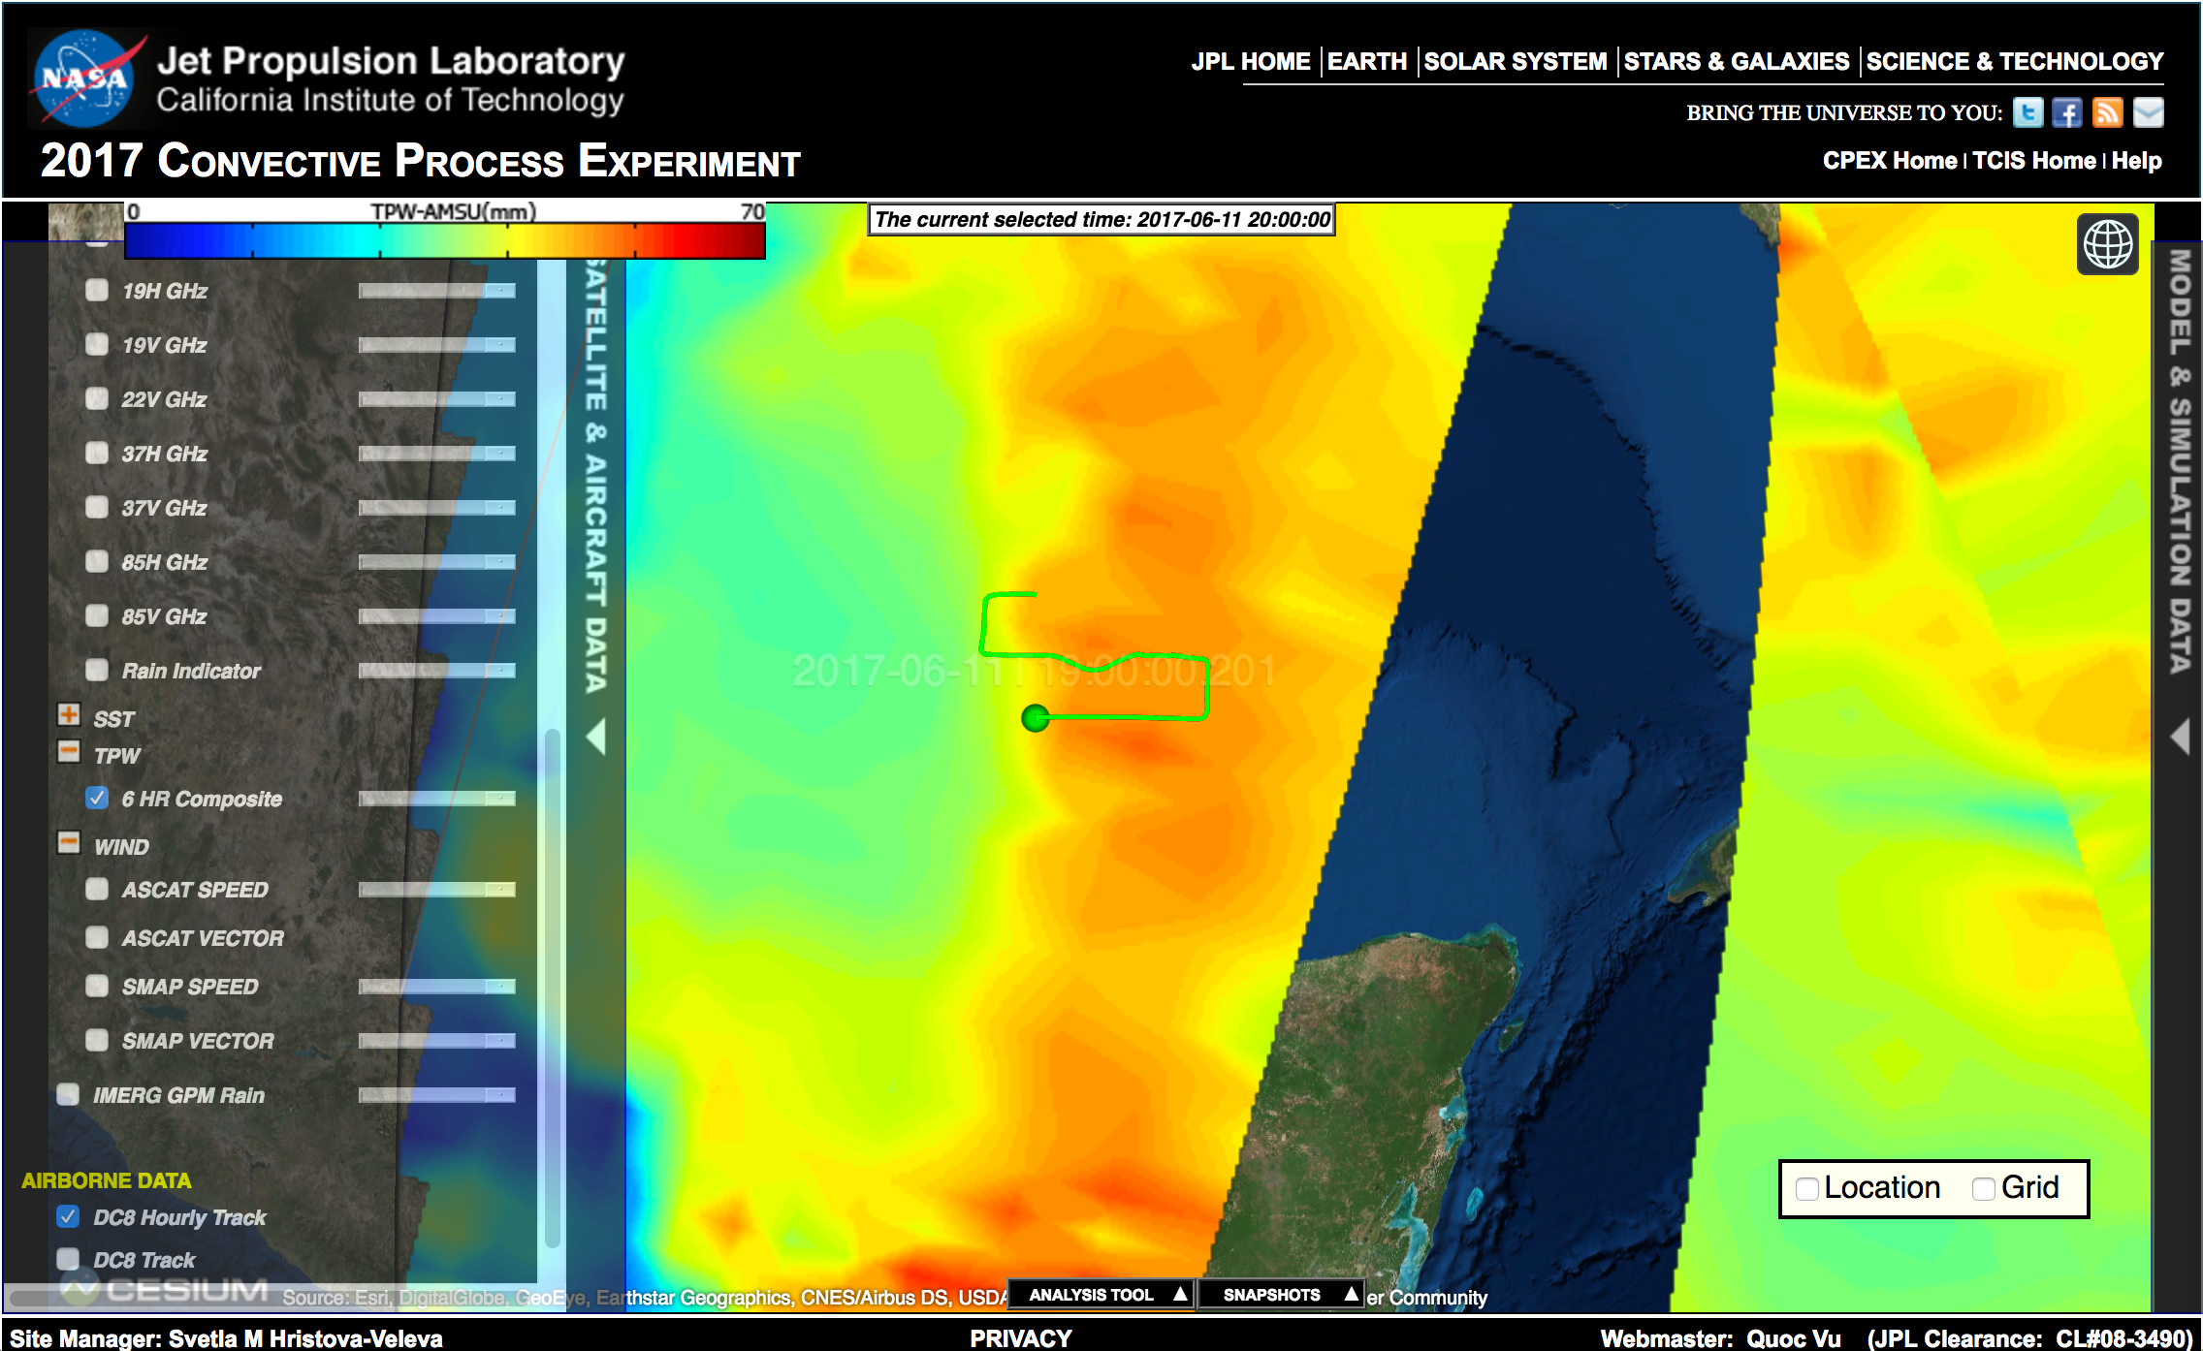
TPW from AMSU: 6h composite at 20Z

Slide 20
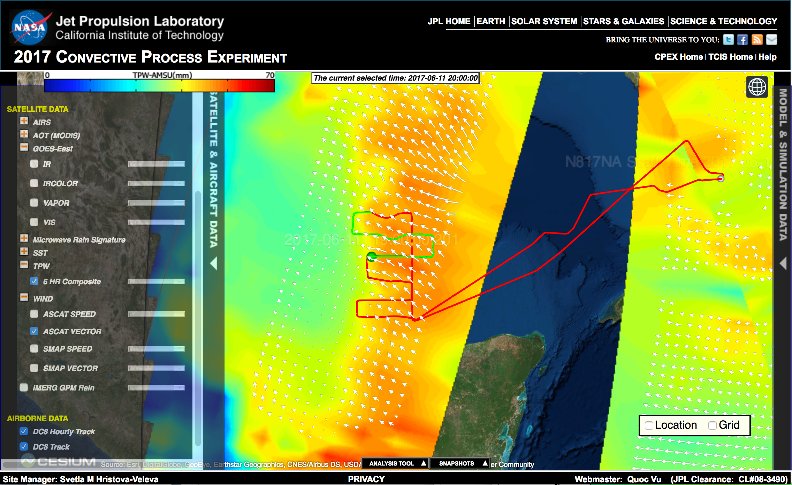
TPW from AMSU; 6h composite at 20Z ASCAT at 16Z On the 11th

Slide 21
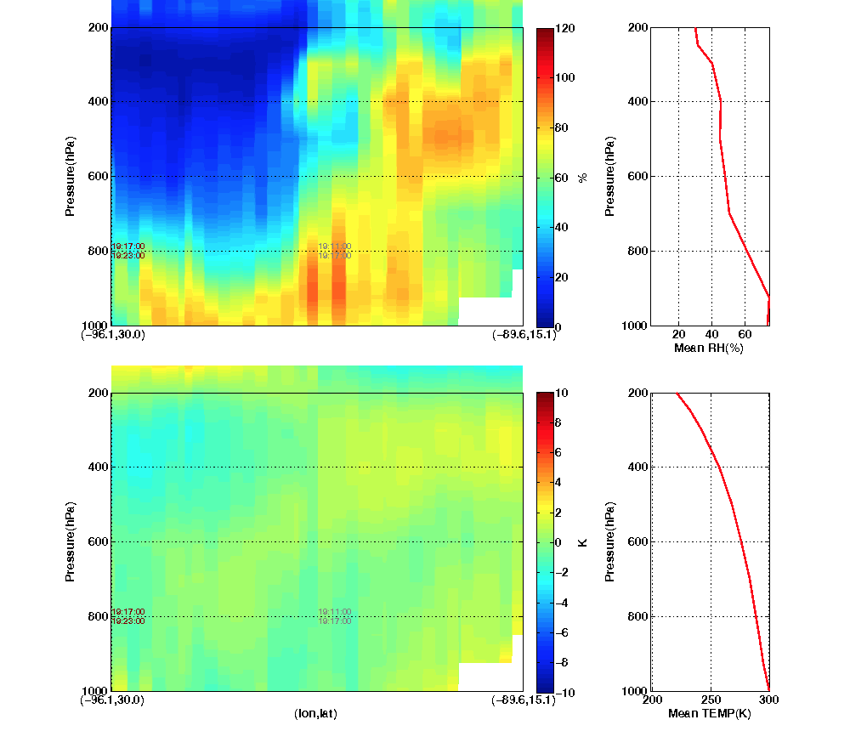
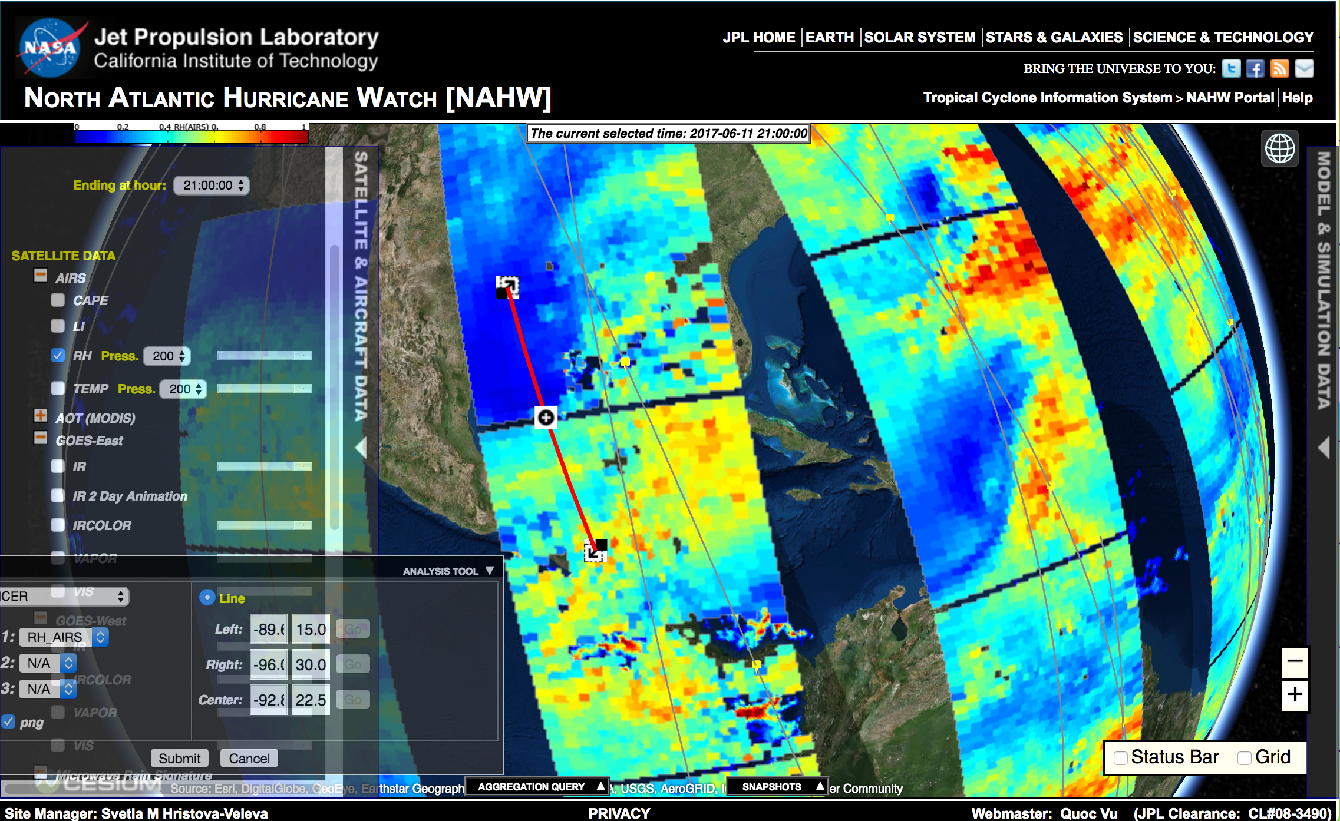
AIRS; Relative humidity at 200 mb The “Slicer” Analysis Tool

Slide 22
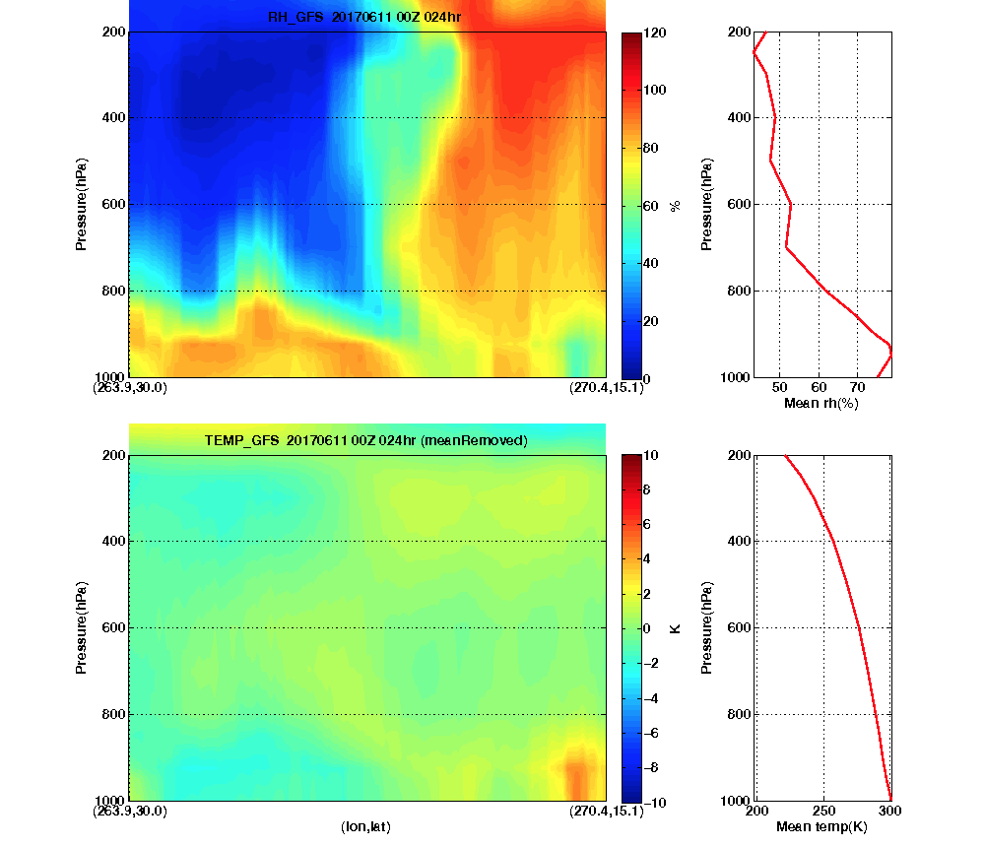
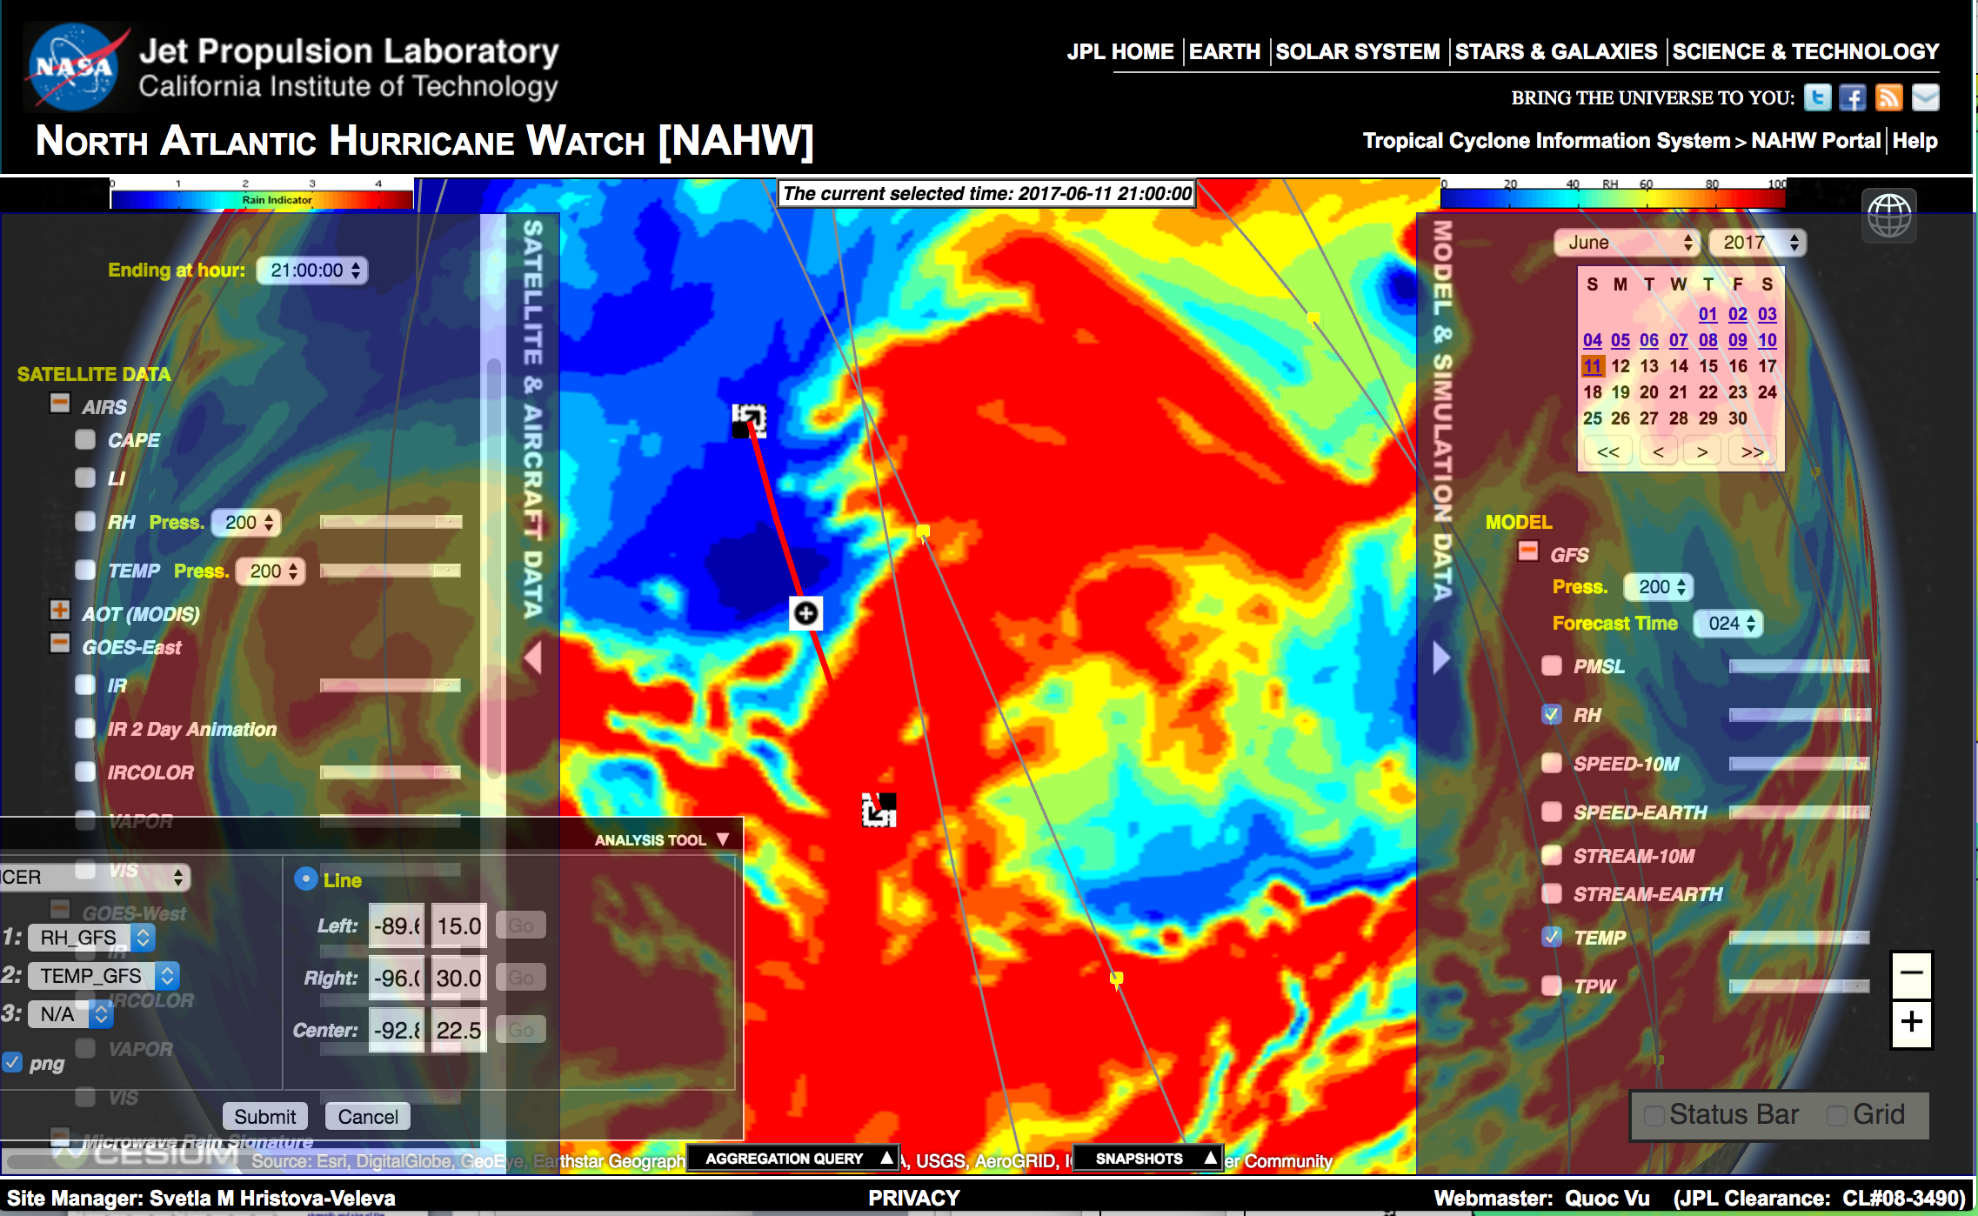
GFS; Relative humidity at 200 mb The “Slicer” Analysis Tool

Slide 23
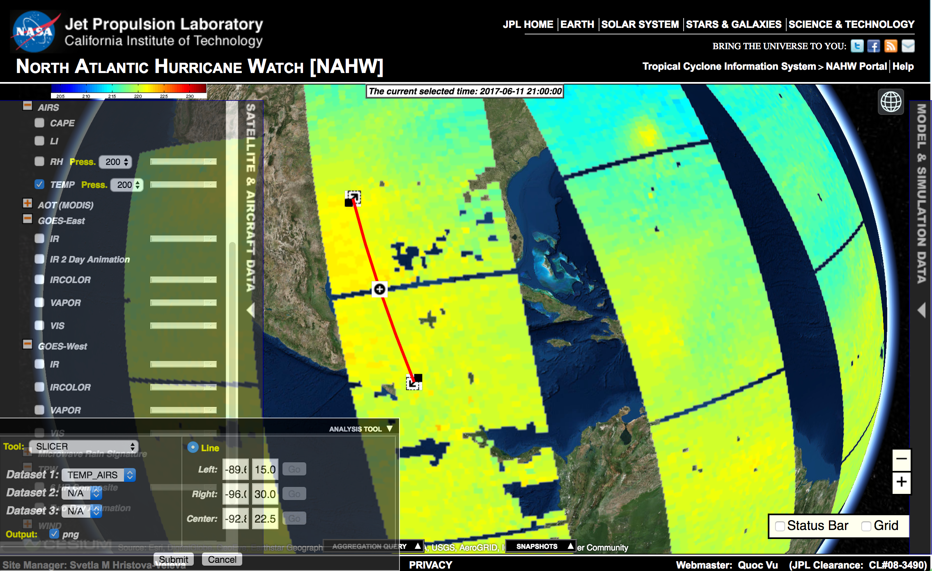

Slide 24
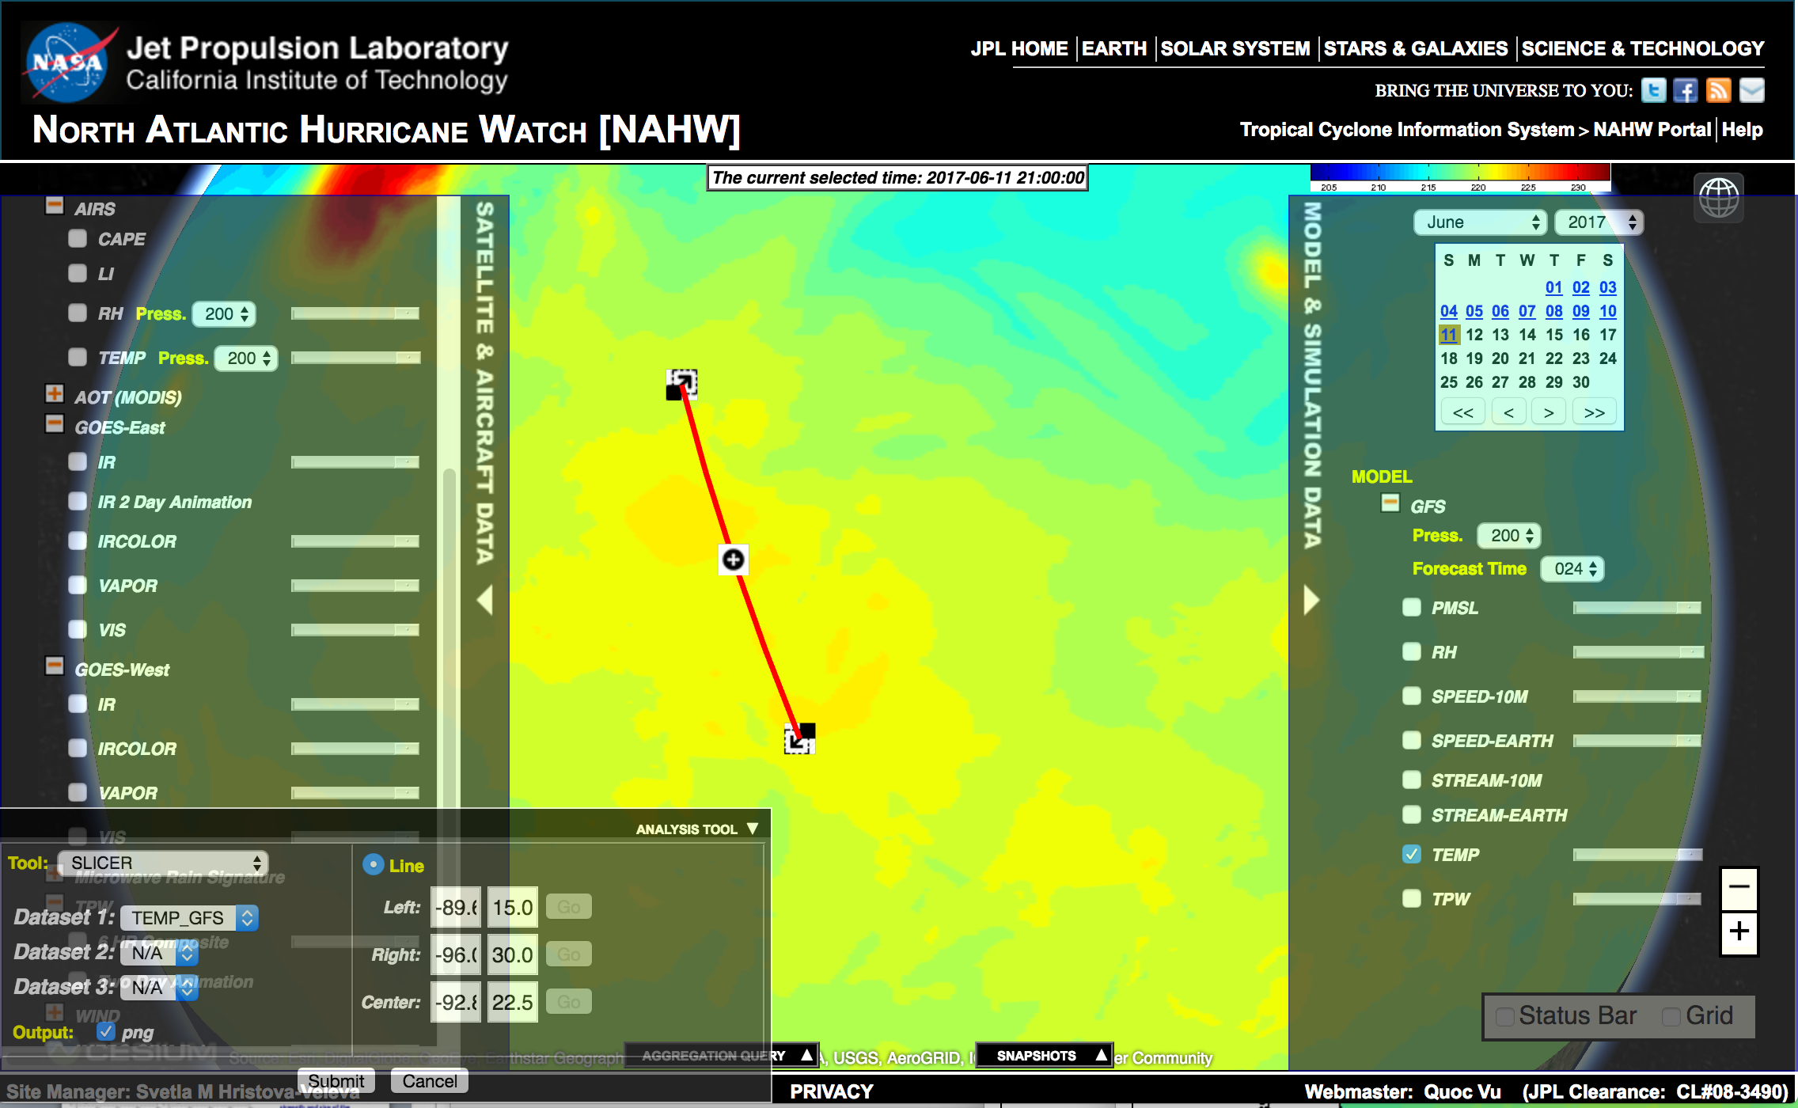

Slide 25
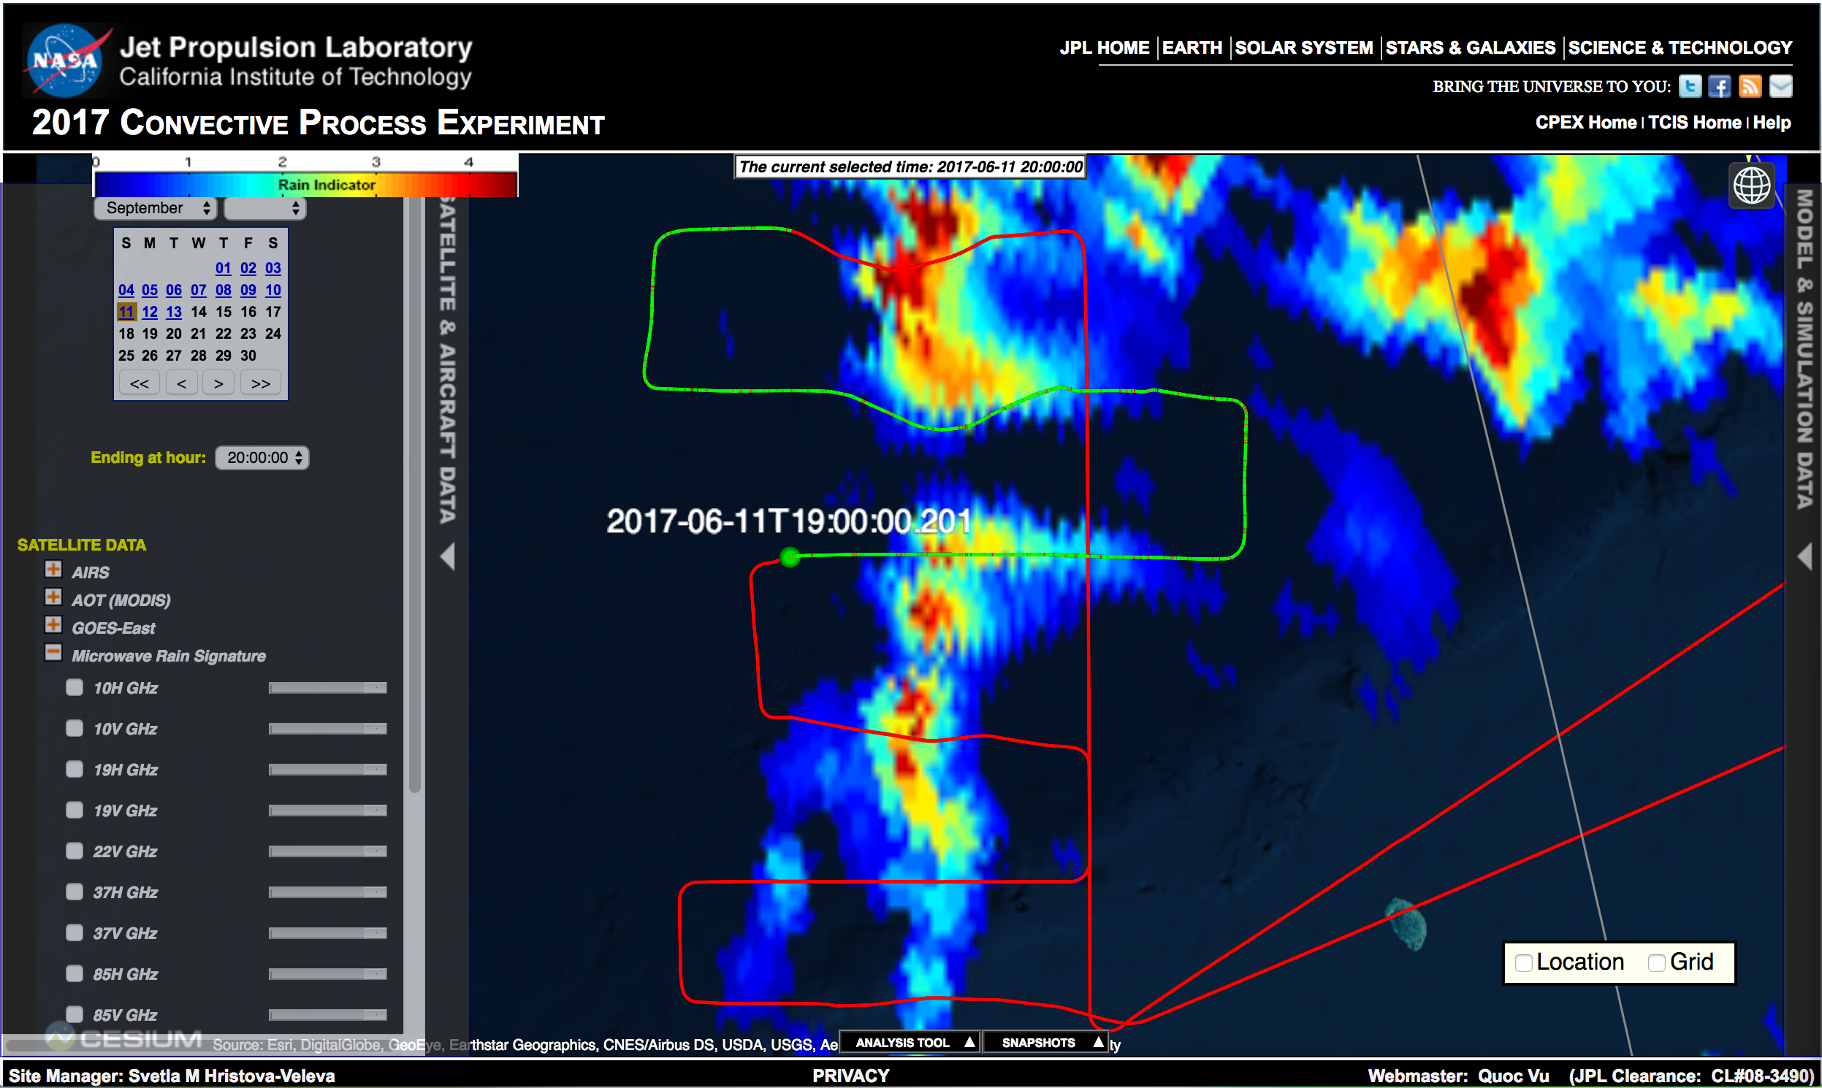

Slide 26
UPDATES

Slide 27
UPDATES: mwsci FTP Site Shutdown
NASA is moving away from the FTP protocol and shutting down the majority of its FTP sites
Many DAACs have already shut down their FTP sites and started offering data services through other protocols
The mwsci FTP site will be turned off on June 29, 2018
All the data will be moved to a public HTTPS service at:
https://mwsci.jpl.nasa.gov/data

Slide 28
UPDATES: the mission video Ryan Bennet (Dave VanGilst)
Currently in the process of compressing the video so that it will not take up so much space
Will provide the approximate size very soon.
The housekeeping data - he can have that finished by the end of the week.
“Unfortunately I will be at a different science team meeting next week, so I will not see you all this time. Please relay my update to the group, I will tag up with you as soon as the data is ready.”

Slide 29
Action Items
Is there a need to update any information on team members and contact information
Is there a desire to post any additional information regarding the Science Team Meeting at the CPEX portal?
Agenda
Participants
Presentations?
Summary ?
Other???
Versions – keep multiple
KMZ from DAWN – update???
Ajda now has a great set of QCed Dropsondes!

