Slide 1



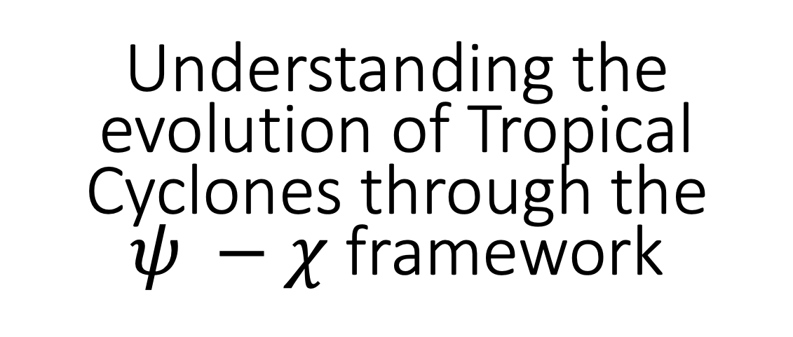
The unique climate variations of Florida and the Challenges it poses
Understanding the evolution of Tropical Cyclones through the $ψ −χ$ framework
Vasu Misra
Ph. D. work of Sweta Das
Dept. of Earth, Ocean, and Atmospheric Science
Florida State University
Center for Ocean-Atmospheric Prediction Studies
Vasu Misra
Department of Earth, Ocean, and Atmospheric Science & Center for Ocean-Atmospheric Prediction Studies,
Florida State University
Florida Climate Institute

Slide 2
Strategy
Cases
Stage
Physics
Cindy 2017
Irma 2017
Michael 2018
Developing
Intensifying
Warm rain (Kessler)
Full Microphysics (WSM6)
12 cases

Slide 3
DESIGN OF EXPERIMENTS
5km grid spacing, single nesting
Microphysics | Developing Phase ‘A’ | Intensification Phase ‘B’
WSM6 (MP1) | MP1A | MP1B
Kessler (MP2) | MP2A | MP2B
WRF_OPTION | MP1 | MP2
Longwave Radiation | RRTMG scheme | RRTMG scheme
Shortwave Radiation | RRTMG scheme | RRTMG scheme
Surface-Layer Option | MM5 Monin-Obukhov scheme | MM5 Monin-Obukhov scheme
Land-Surface option | Thermal diffusion scheme | Thermal diffusion scheme
Boundary-Layer Option | YSU scheme | YSU scheme
Cumulus Option | Kain-Fritsch (new Eta) scheme | Kain-Fritsch (new Eta) scheme

Slide 4
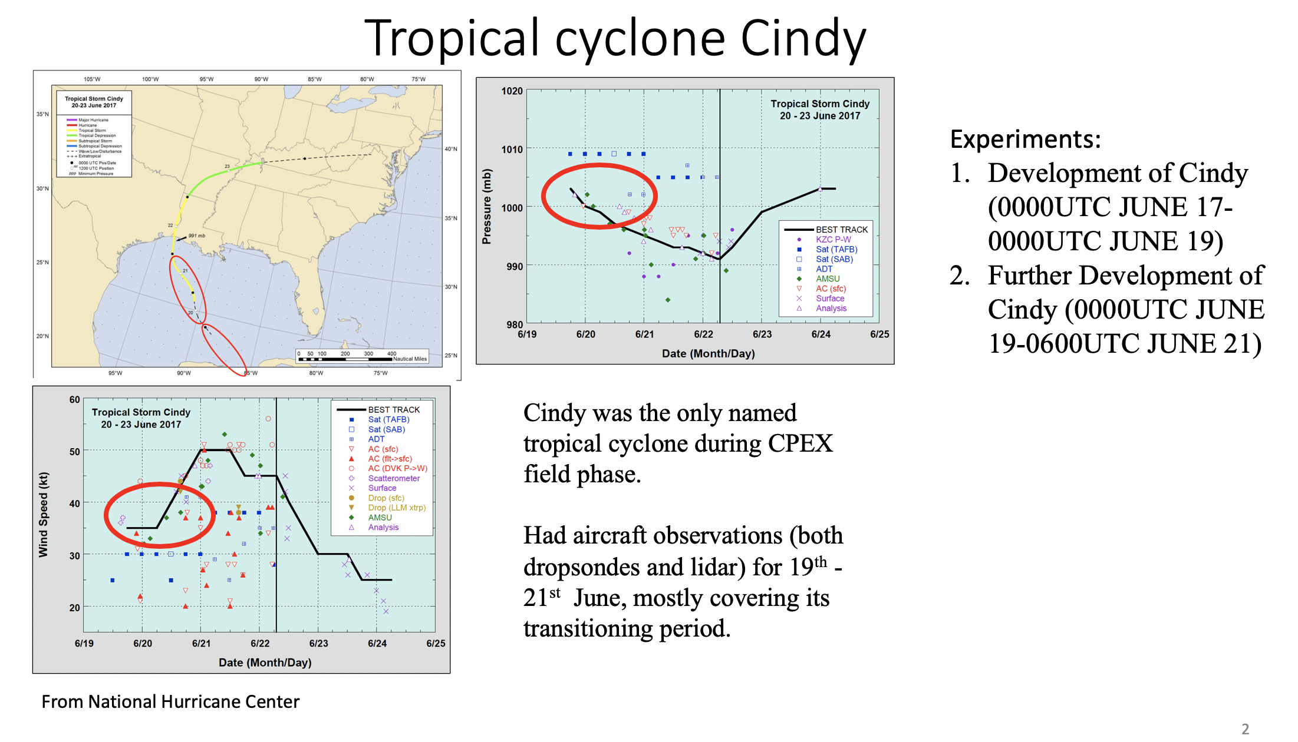
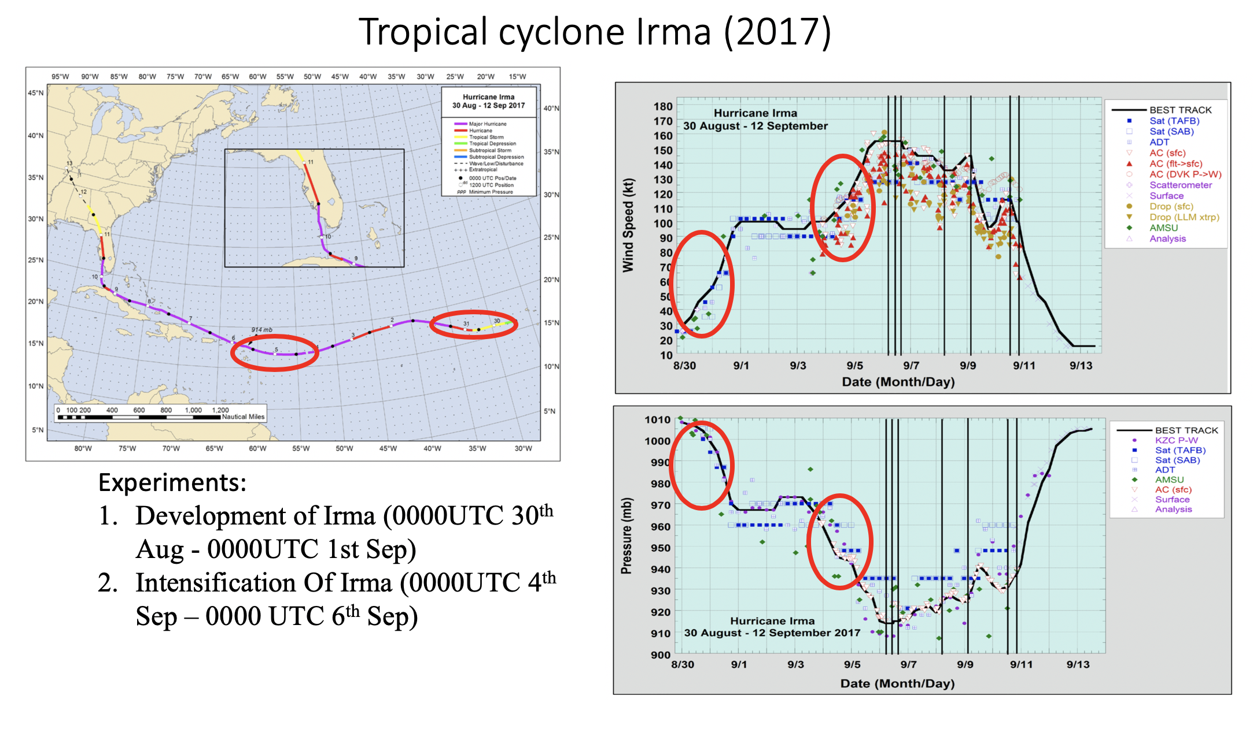
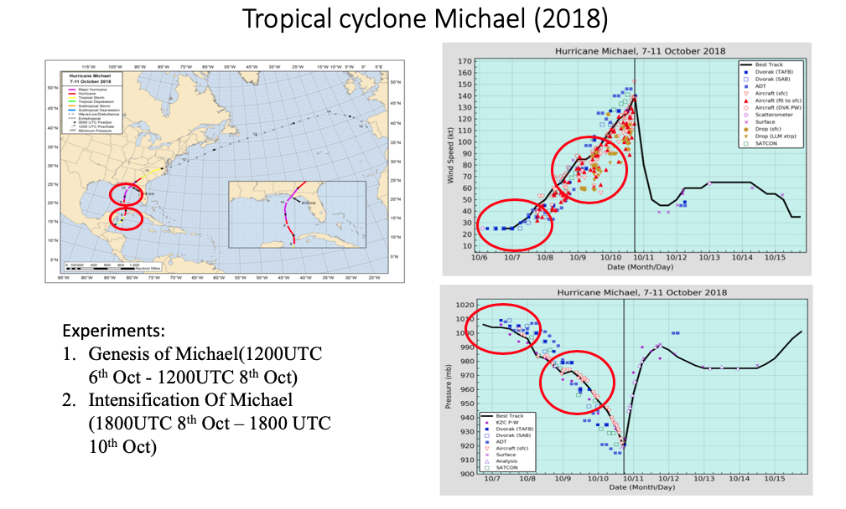

Slide 5
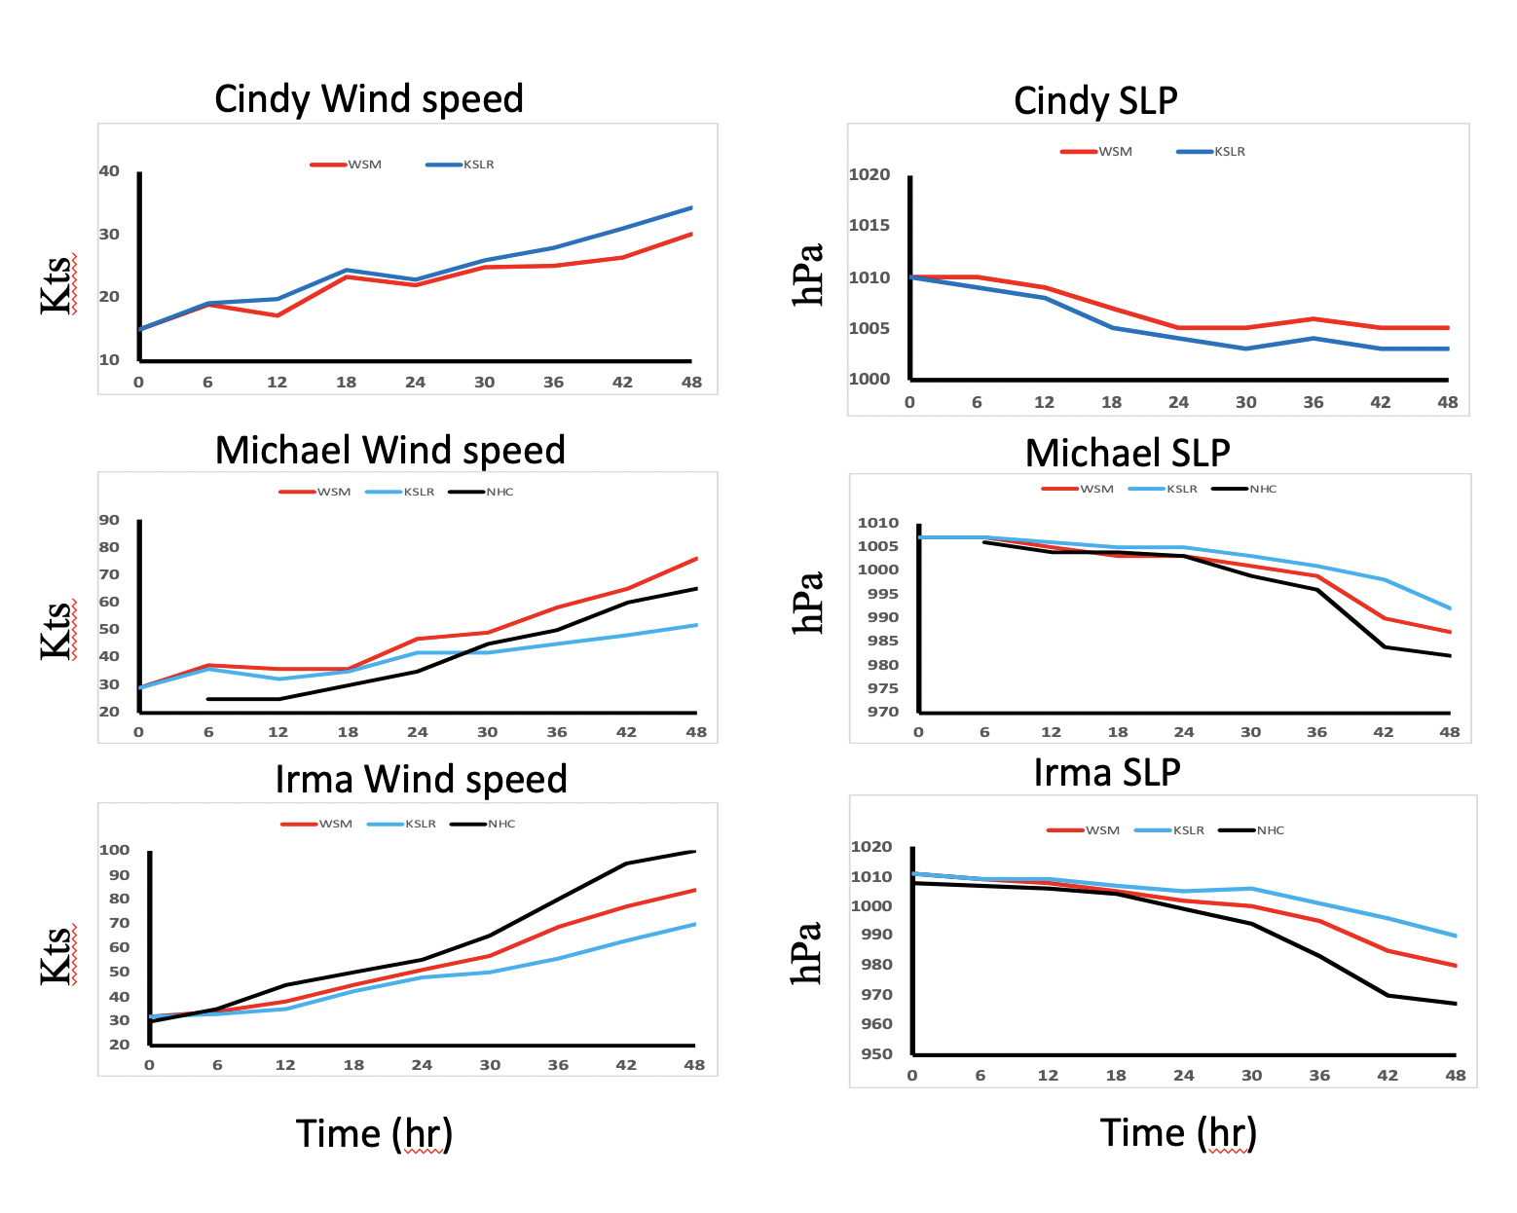
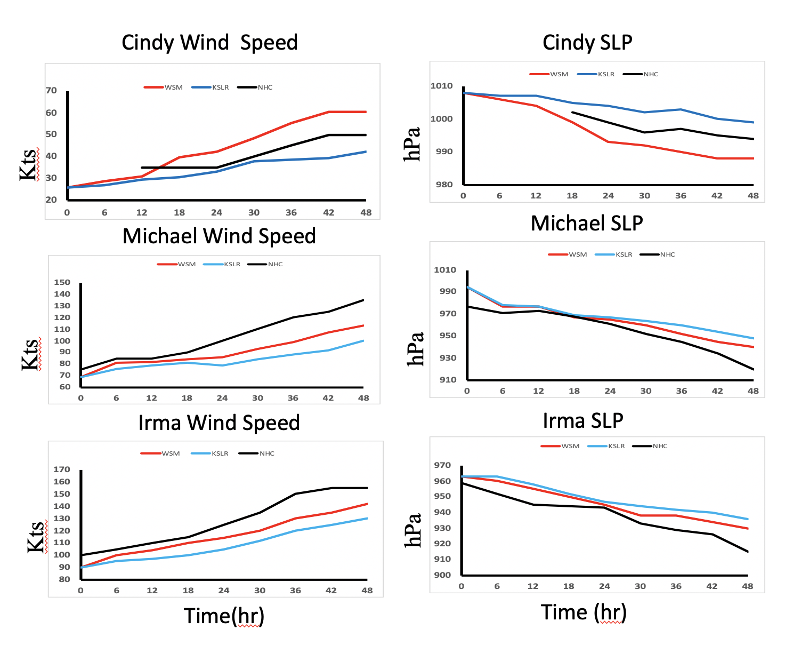
Verification
Development
Intensification
Kessler underestimates and WSM overestimates except in case of Cindy in the developing stage

Slide 6
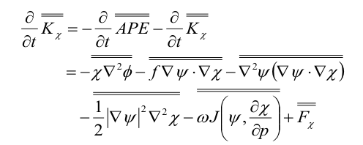
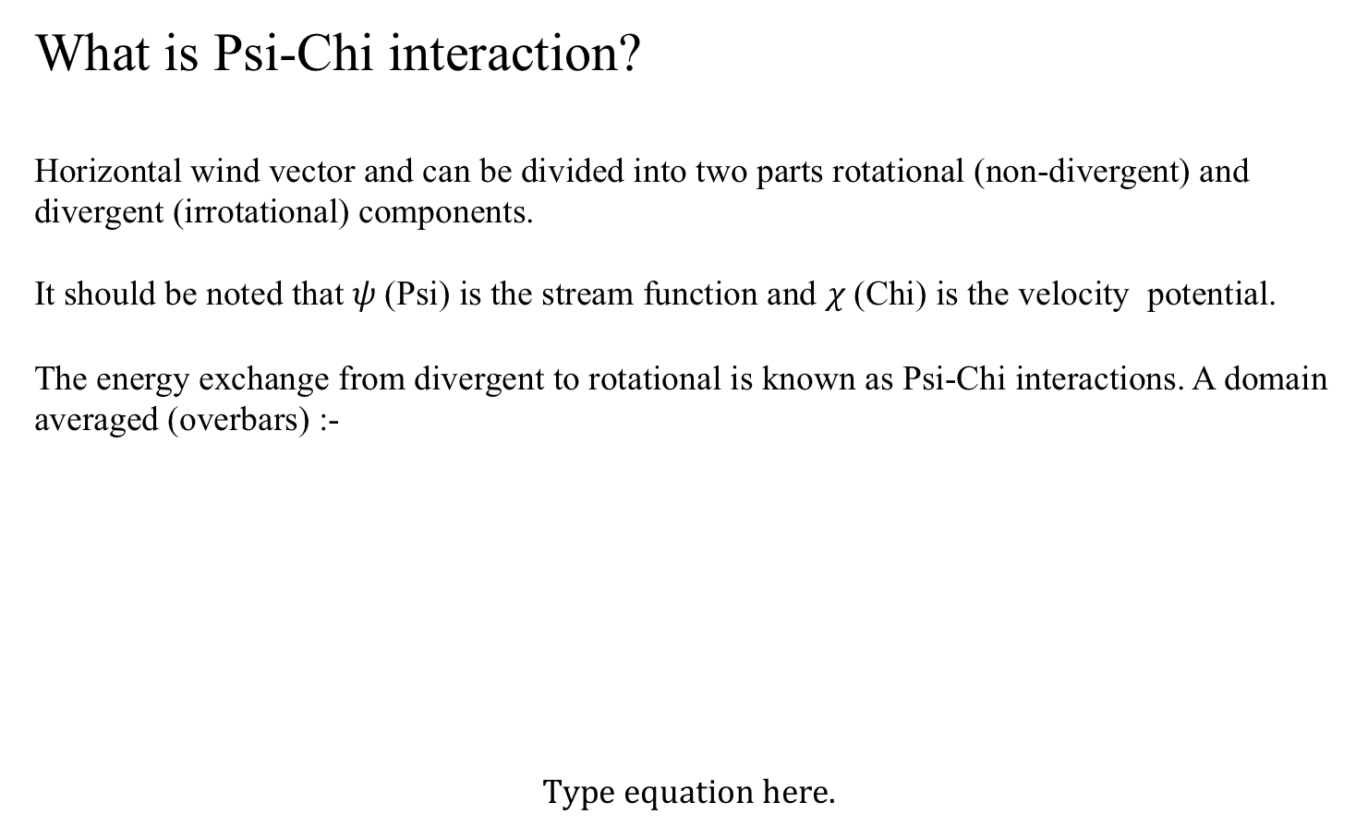
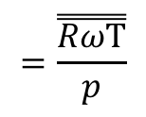
What is Psi-Chi interaction?
Horizontal wind vector and can be divided into two parts rotational (non-divergent) and divergent (irrotational) components.
It should be noted that $ψ$(Psi) is the stream function and $χ$(Chi) is the velocity potential.
The energy exchange from divergent to rotational is known as Psi-Chi interactions. A domain averaged (overbars) :-
Eqn. 1
Eqn. 2
$$=\overset{̿}{\frac{RωΤ}{p}}$$
Eqn. 3

Slide 7
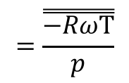
The energy exchange from divergent to rotational is known as Psi-Chi interactions. A domain averaged (overbars) :-
Eqn. 1
Term1
10 ⁻⁴
Term2
10 ⁻⁴
Term3
10 ⁻⁵
Term4
10 ⁻⁶
Four terms appear as a ‘source’ in eqn. 1 while they behave as ‘sink’ in eqn.2
APE appears in eqn. 2 and that causes generation of irrotational kinetic energy which eventually transforms to non divergent kinetic through the other four terms
Eqn. 2
$$=\overset{̿}{\frac{−RωΤ}{p}}$$
Eqn. 3

Slide 8
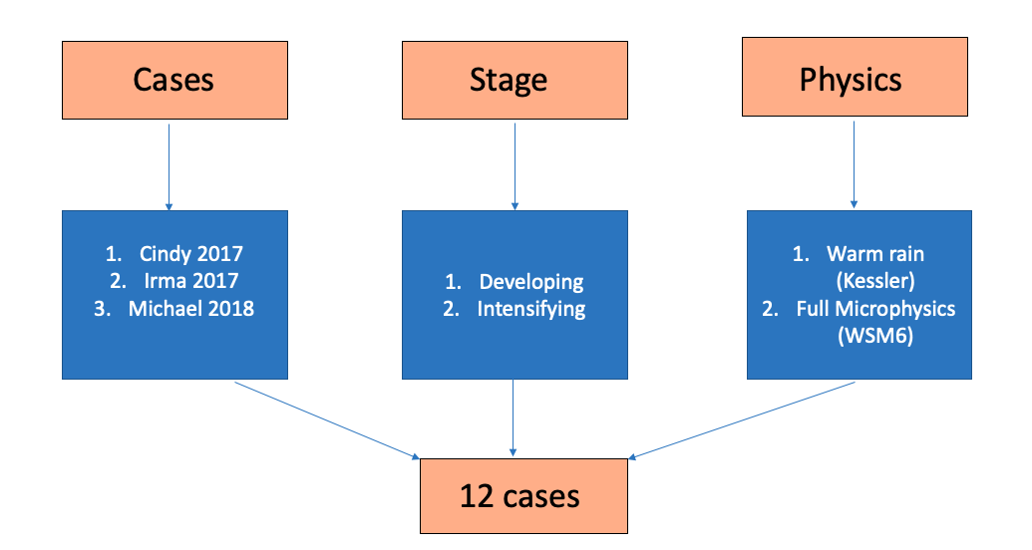
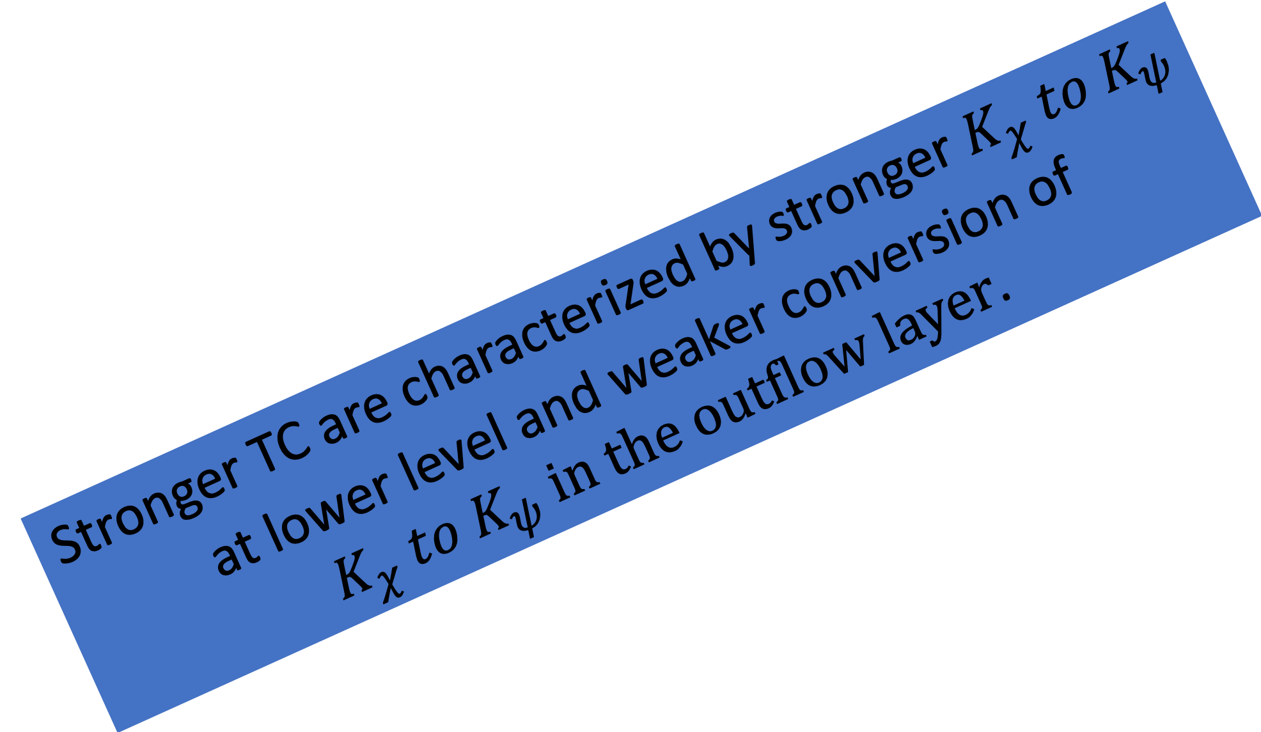


Time series of fractional conversion from irrotational ($\overset{̿}{K_{χ}}$) to non-divergent ($\overset{̿}{K_{ψ}}$) component for different TCs.
Lower level
($\overset{̿}{K_{ψ}}$- $\overset{̿}{K_{χ}}$)/$\overset{̿}{K_{ψ}}$)%
Stronger TC are characterized by stronger $K_{χ} to K_{ψ}$ at lower level and weaker conversion of $K_{χ} to K_{ψ} in the outflow layer$.
Outflow Level
($\overset{̿}{K_{ψ}}$- $\overset{̿}{K_{χ}}$)/$\overset{̿}{K_{ψ}}$)%
Time (hr)

Slide 9
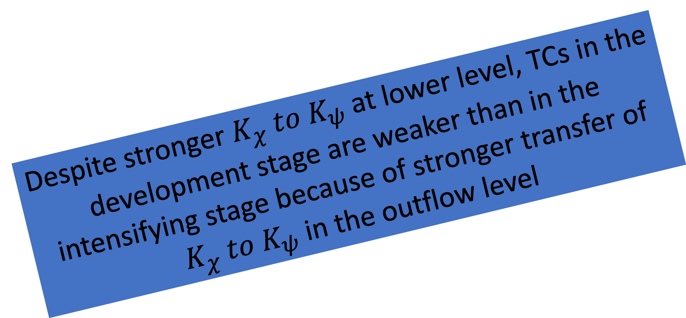


Time series of fractional conversion from irrotational ($\overset{̿}{K_{χ}}$) to non-divergent ($\overset{̿}{K_{ψ}}$) component for Michael intensification vs development (WSM6).
Lower Level
($\overset{̿}{K_{ψ}}$- $\overset{̿}{K_{χ}}$)/$\overset{̿}{K_{ψ}}$)%
Despite stronger $K_{χ} to K_{ψ}$ at lower level, TCs in the development stage are weaker than in the intensifying stage because of stronger transfer of $K_{χ} to K_{ψ}$ in the outflow level
Outflow Level
($\overset{̿}{K_{ψ}}$- $\overset{̿}{K_{χ}}$)/$\overset{̿}{K_{ψ}}$)%
Time (hr)

Slide 10
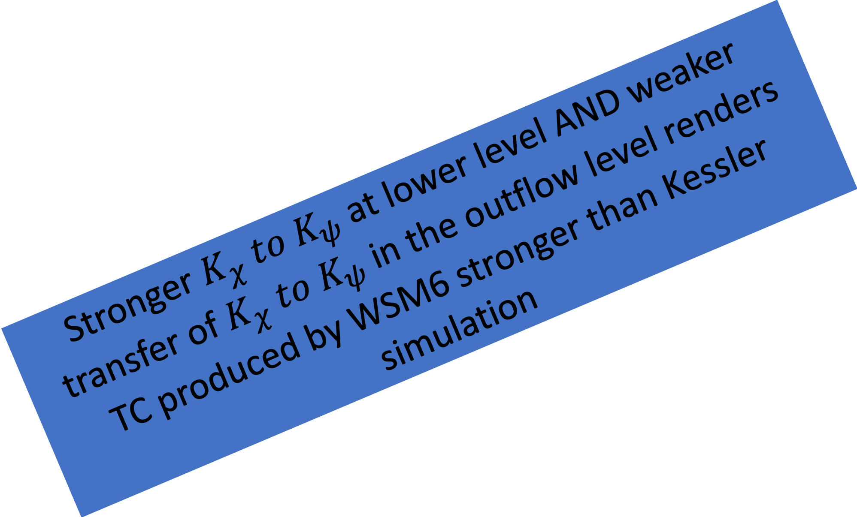


Time series of fractional conversion from irrotational ($\overset{̿}{K_{χ}}$) to non-divergent ($\overset{̿}{K_{ψ}}$) component for Michael intensification
(WSM6 vs KSLR).
Lower Level
($\overset{̿}{K_{ψ}}$- $\overset{̿}{K_{χ}}$)/ $\overset{̿}{K_{ψ}}$)%
Stronger $K_{χ} to K_{ψ}$ at lower level AND weaker transfer of $K_{χ} to K_{ψ}$in the outflow level renders TC produced by WSM6 stronger than Kessler simulation
Outflow Level
($\overset{̿}{K_{ψ}}$- $\overset{̿}{K_{χ}}$)/$\overset{̿}{K_{ψ}}$)%

Slide 11
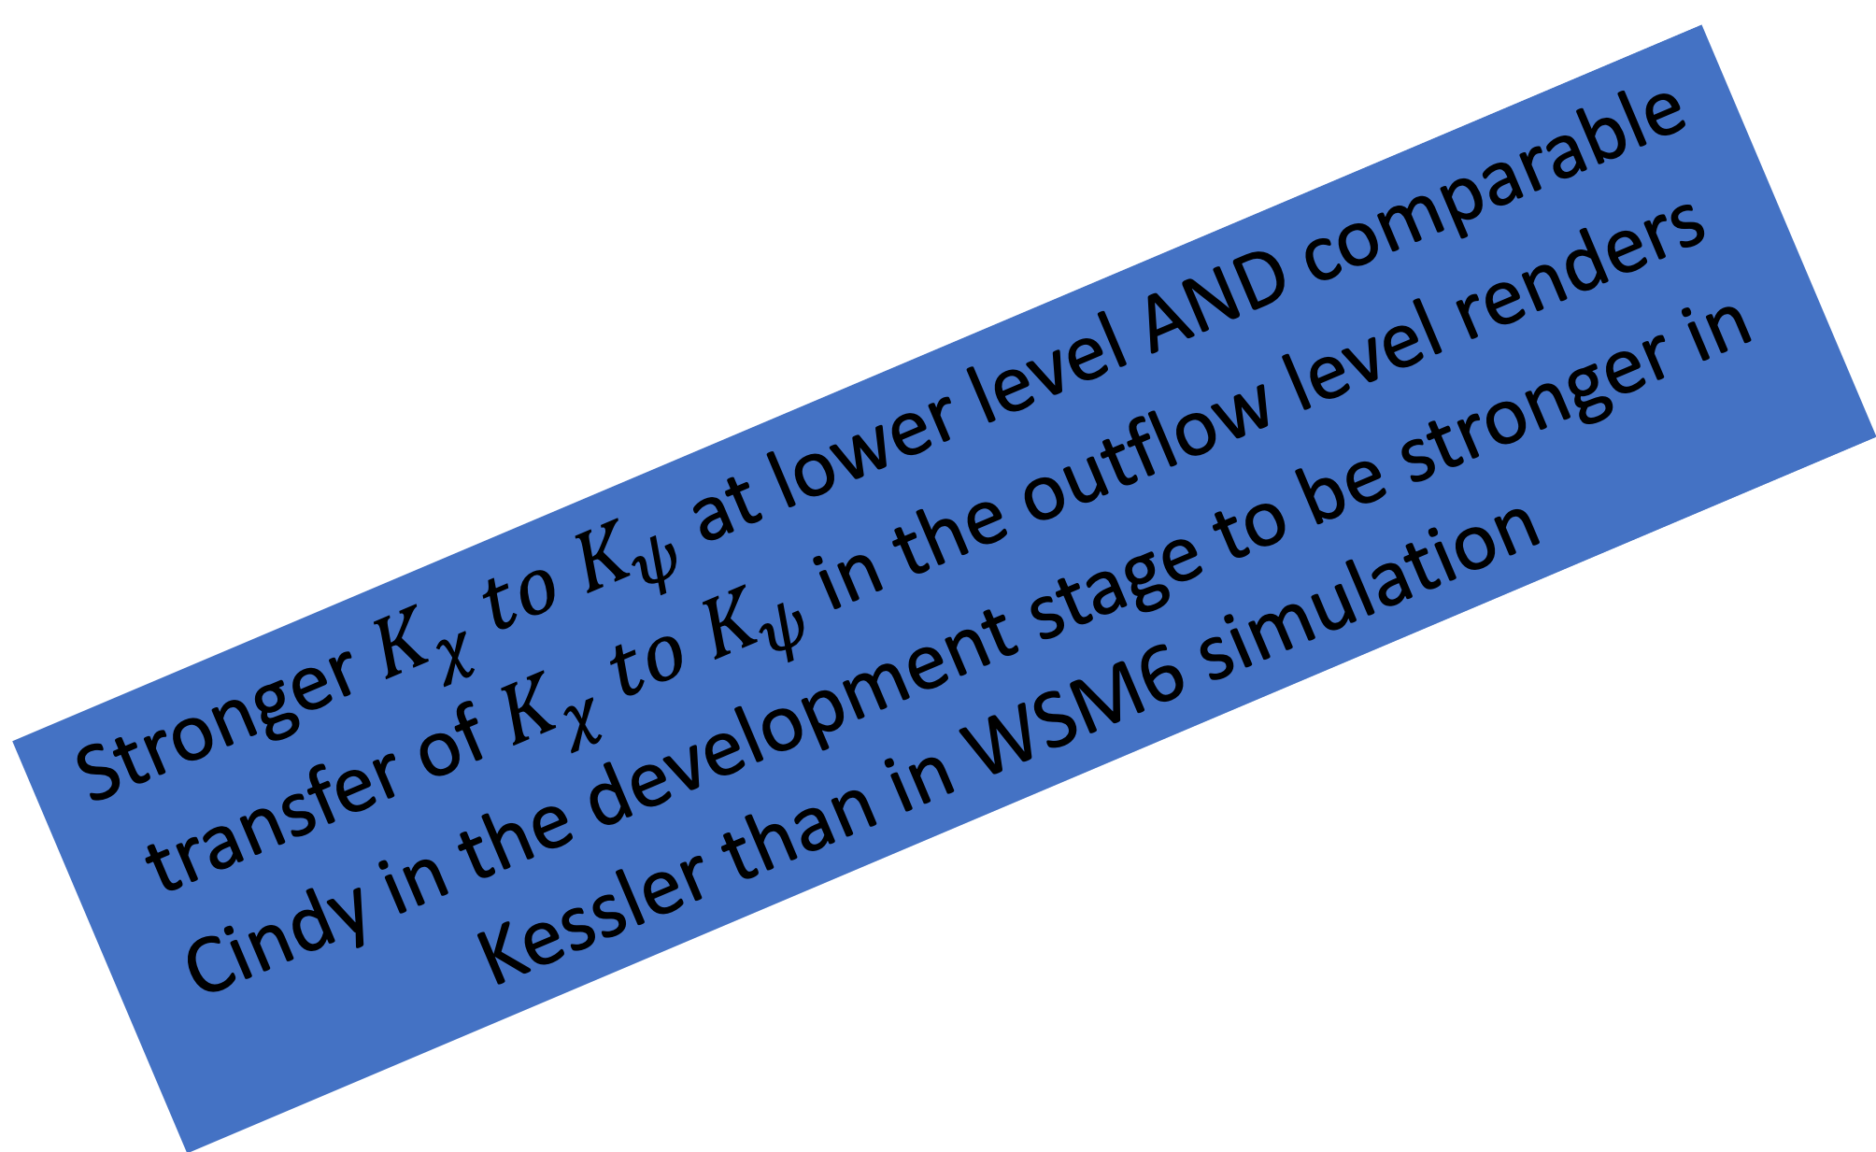


Time series of fractional conversion from irrotational ($\overset{̿}{K_{χ}}$) to non-divergent ($\overset{̿}{K_{ψ}}$) component for Cindy development (WSM6 vs KSLR).
850hPa Level
($\overset{̿}{K_{ψ}}$- $\overset{̿}{K_{χ}}$)/ $\overset{̿}{K_{ψ}}$)%
Stronger $K_{χ} to K_{ψ}$ at lower level AND comparable transfer of $K_{χ} to K_{ψ}$in the outflow level renders Cindy in the development stage to be stronger in Kessler than in WSM6 simulation
Outflow Level
($\overset{̿}{K_{ψ}}$- $\overset{̿}{K_{χ}}$)/ $\overset{̿}{K_{ψ}}$)%
Time (hr)

Slide 12
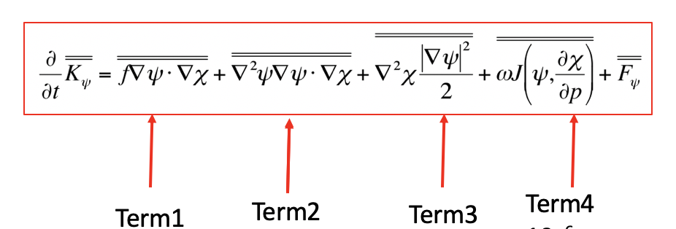

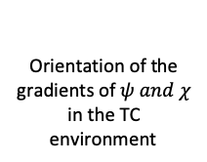
WSM6 Microphysics at intensifying stage
Kessler Microphysics at intensifying stage
Lower Level
Lower Level
Outflow Level
Outflow Level
Term 1 is dominant followed by Term 2 and then Term 3 irrespective of the choice of physics or life cycle of the TC
Time (hr)
Time (hr)
Orientation of the gradients of $ψ and χ$ in the TC environment
Orientation of the gradients of $ψ and χ$ in the region of primary circulation of the TC
Kinetic energy of non-divergent flow in region of strong convergence

Slide 13
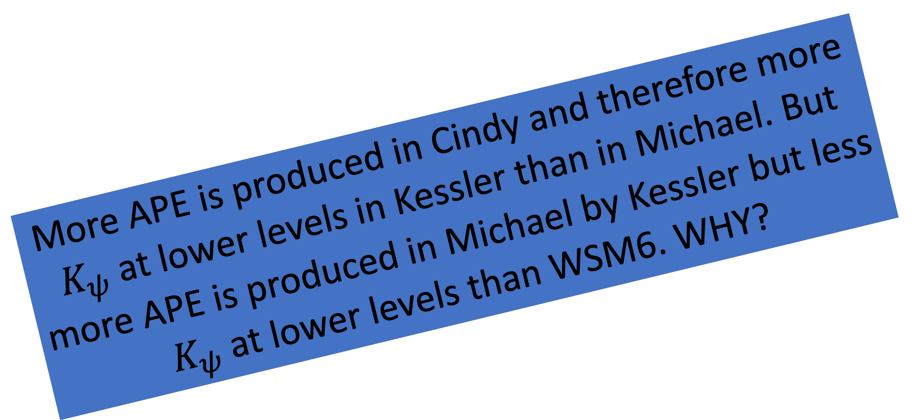
Time series of domain averaged available potential energy for Michael and Cindy (WSM6 vs KSLR) ${ \left(in 10−2 m2 s−3\right).}_{ }$
Lower Level
More APE is produced in Cindy and therefore more $K_{ψ}$ at lower levels in Kessler than in Michael. But more APE is produced in Michael by Kessler but less $K_{ψ}$ at lower levels than WSM6. WHY?
APE
Outflow Level
APE
Time (hr)

Slide 14
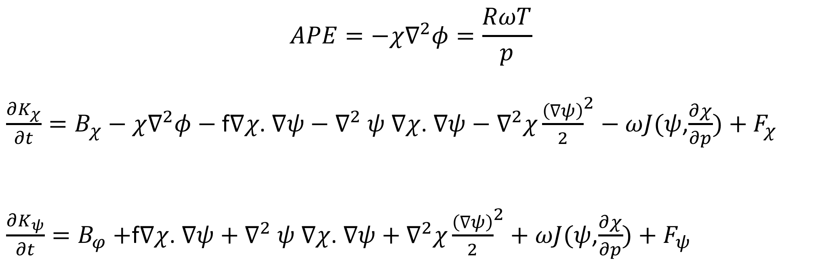
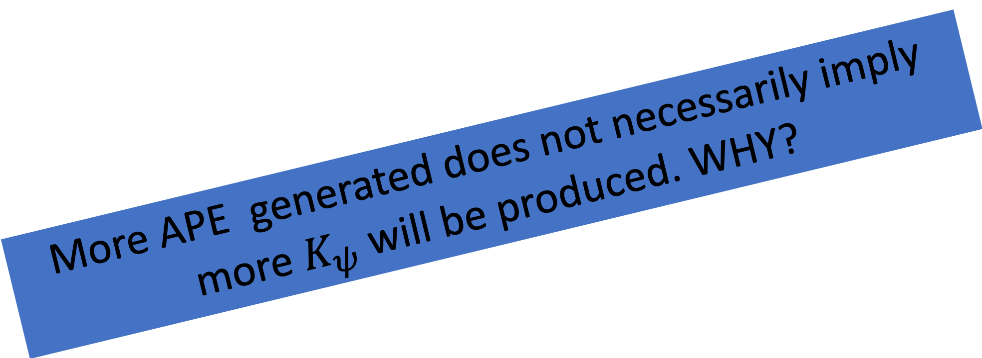
The $ψ−χ$ interaction
$$APE=−χ∇^{2}φ=\frac{RωT}{p}$$
$\frac{∂K_{χ}}{∂t}=B_{χ}−χ∇^{2}φ−$f$∇χ$. $∇ψ−∇^{2}$ $ψ$ $∇χ$. $∇ψ−$ $∇^{2}χ{\frac{\left(∇ψ\right)}{2}}^{2}−ωJ(ψ$,$\frac{∂χ}{∂p})+F_{χ}$
$\frac{∂K_{ψ}}{∂t}=B_{φ}+$f$∇χ$. $∇ψ+$ $∇^{2}$ $ψ$ $∇χ$. $∇ψ+$ $∇^{2}χ{\frac{\left(∇ψ\right)}{2}}^{2}+ωJ(ψ$,$\frac{∂χ}{∂p})+F_{ψ}$
Model physics determines this
More APE generated does not necessarily imply more $K_{ψ}$will be produced. WHY?
Overbars (area averages) removed for convenience!

Slide 15
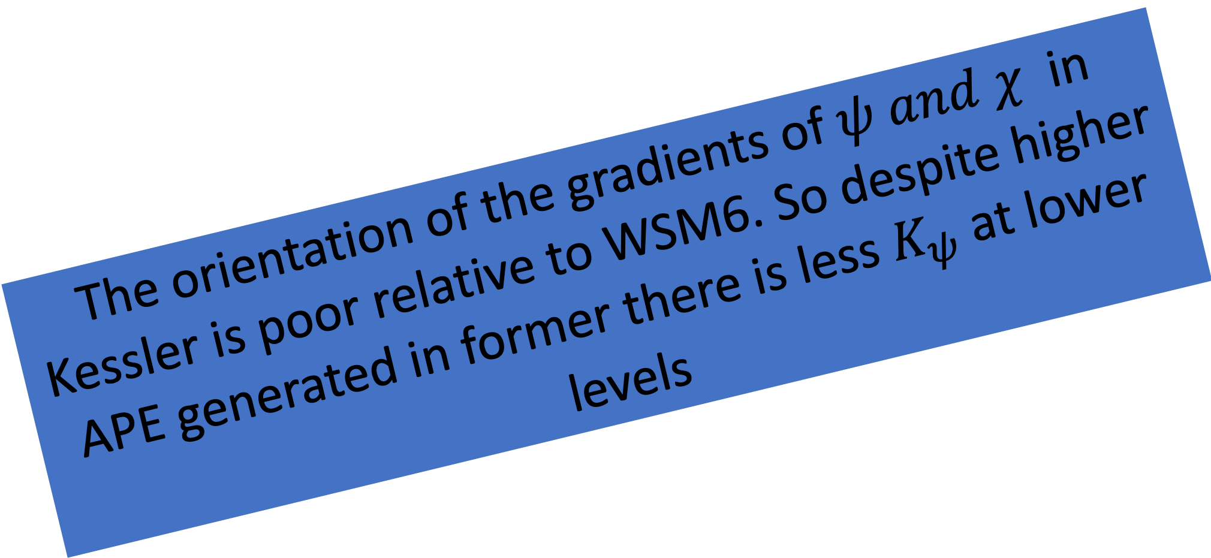
$\vec{∇χ}\text{. }\vec{∇ψ }$ vs $θ$ plots for Michael intensification (WSM6 vs Kessler ) at lower level for the time steps where the difference between the two simulations is greatest
$\vec{∇χ}\text{. }\vec{∇ψ }$ along y-axis and $θ$ along x-axis.
WSM- 42nd hr
KSLR-42nd hr
The orientation of the gradients of $ψ and χ$ in Kessler is poor relative to WSM6. So despite higher APE generated in former there is less $K_{ψ}$ at lower levels
f∇ᴪ.∇𝛘 = {abs(∇ᴪ) abs (∇𝛘 )}cosθ
θ =cos⁻¹ [f ∇ᴪ.∇𝛘/{abs(∇ᴪ) abs (∇𝛘 )}]

Slide 16
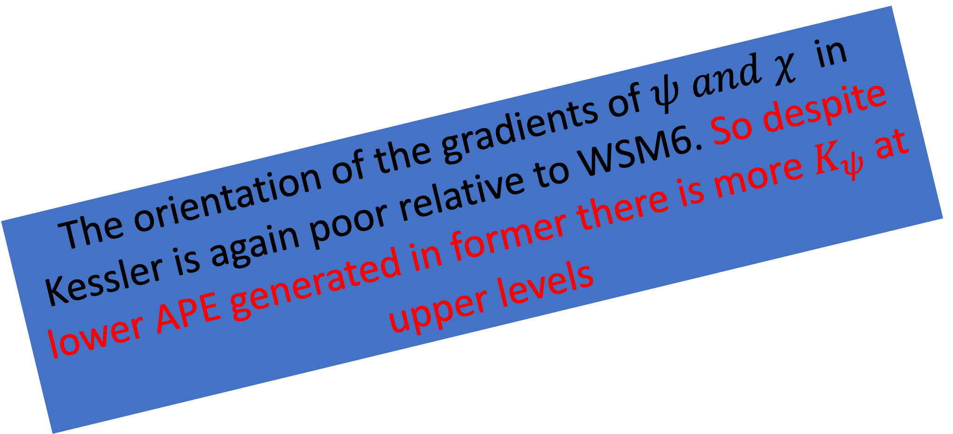
$\vec{∇χ}\text{. }\vec{∇ψ }$ vs $θ$ plots for Michael intensification (WSM6 vs Kessler ) at outflow level for the time steps where the difference of the two schemes are most noticeable.
$\vec{∇χ}\text{. }\vec{∇ψ }$ along y-axis and $θ$ along x-axis.
WSM6- 42nd hr
KSLR- 42nd hr
The orientation of the gradients of $ψ and χ$ in Kessler is again poor relative to WSM6. So despite lower APE generated in former there is more $K_{ψ}$ at upper levels

Slide 17

Conclusions
The transformation of irrotational kinetic energy to non-divergent kinetic energy in the lower troposphere within the TC environment leads to further growth/intensification of the TC.
The transformation of irrotational kinetic energy to non-divergent kinetic energy within the TC outflow layer leads to weakening of the TC as a result of increasing the inertial stability in the outflow level.
The dominant players of this energy transformation is the dot product of the large-scale gradients of velocity potential and streamfunction in the region of the primary circulation of the TC, followed by the same dot product in regions of strong cyclonic vorticity and kinetic energy of non-divergent component of the wind in the vicinity of strong convergence
The above points are observed to appreciate the :
  Contrast between stronger and weaker TCs
  Contrast between developing and intensifying stages of TC
  Contrast between stronger and weaker storms generated by a particular choice of microphysics

Slide 18
Future work
Does the initial condition, particularly of the orientation of the gradients of velocity potential and stream function dictate the evolution of the tropical cyclone?

